Slide 1
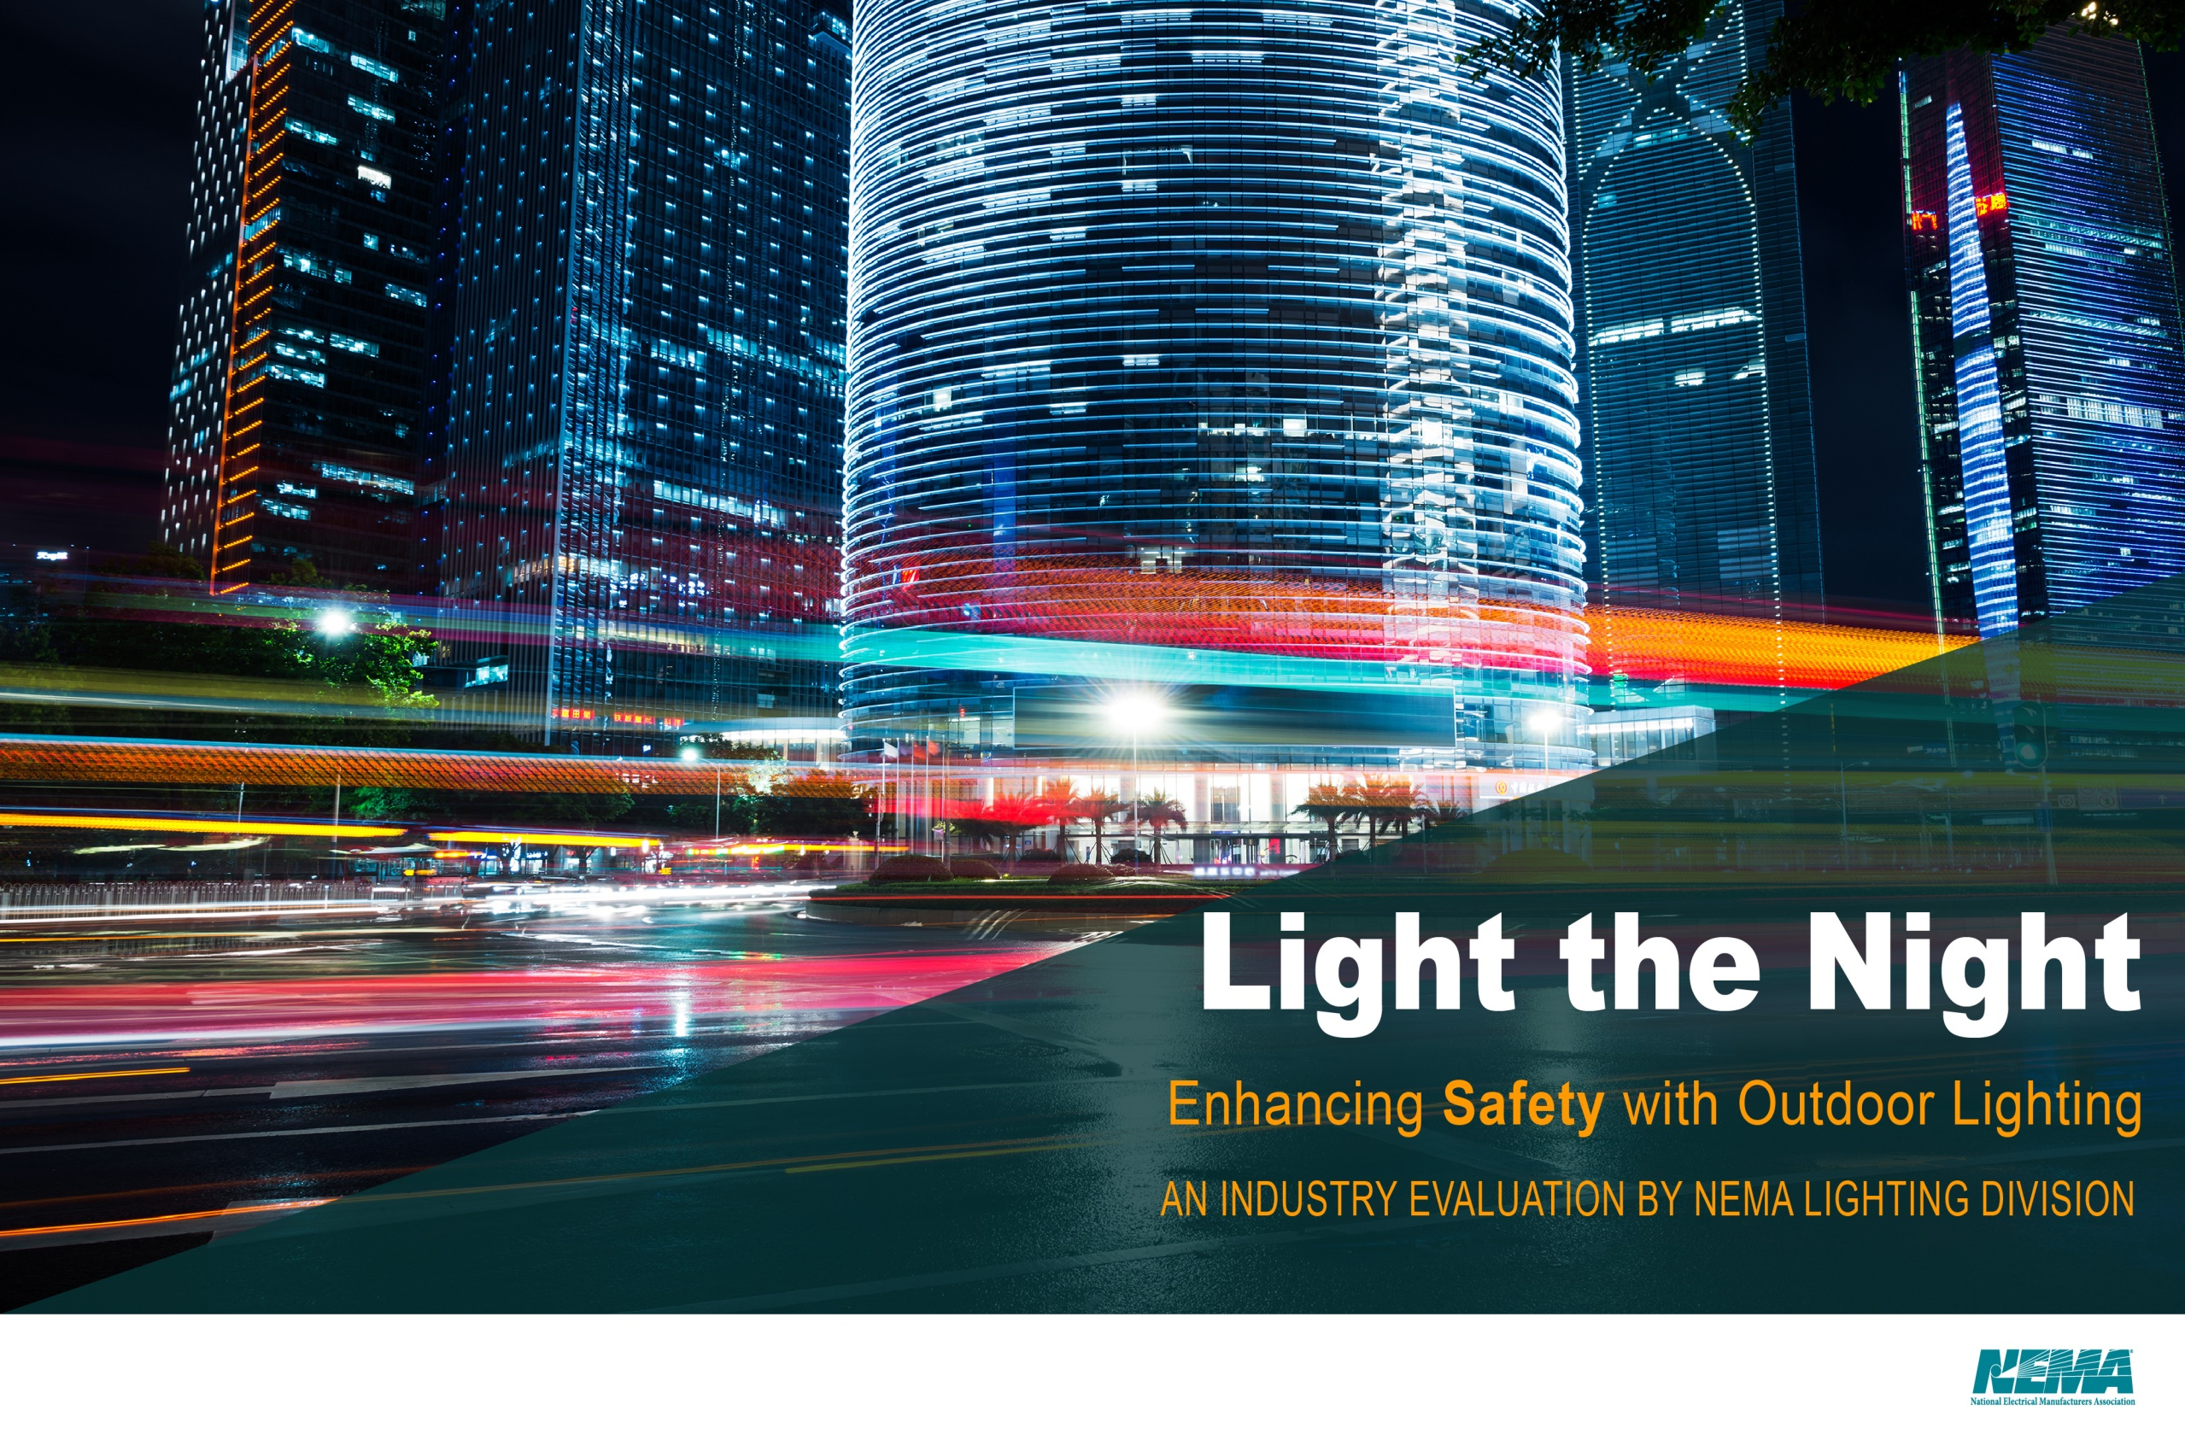

Slide 2
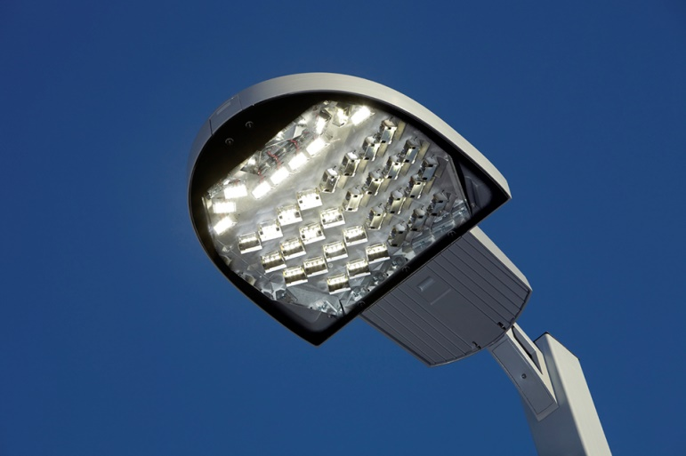
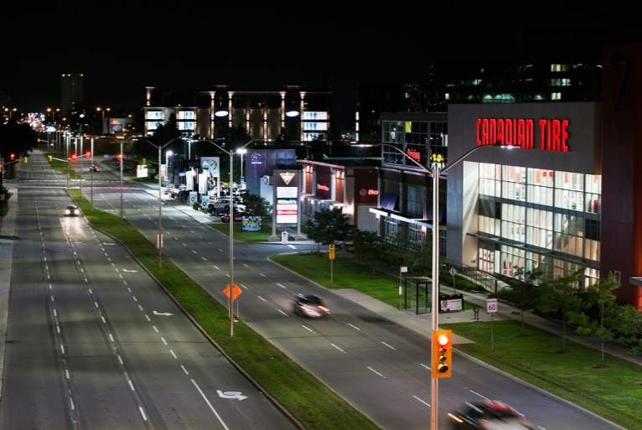
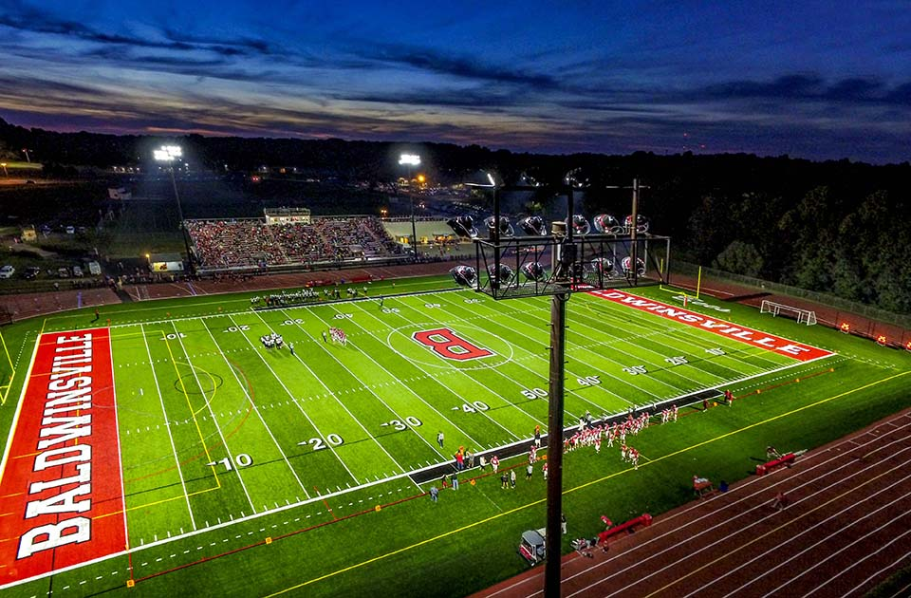
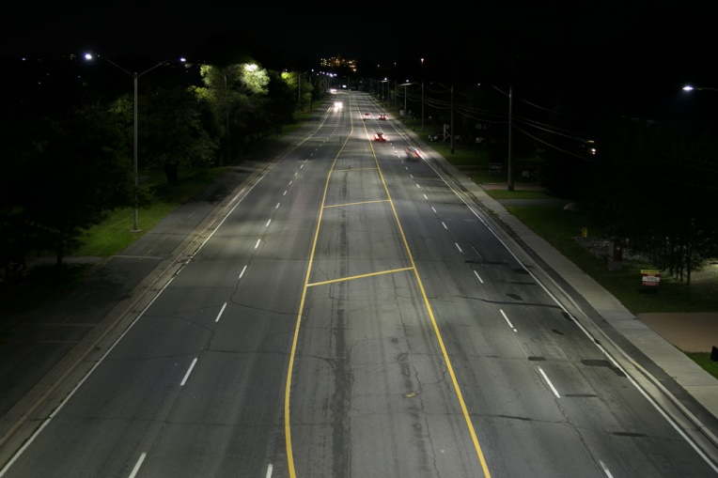
Proper Outdoor Lighting Enhances Safety and Livability

Slide 3
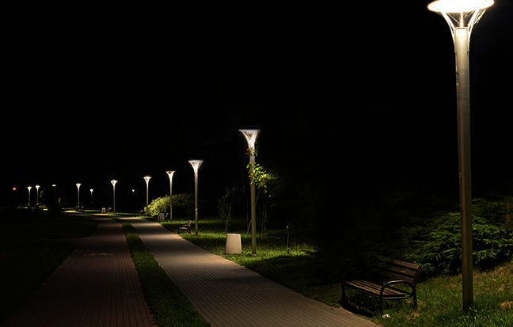
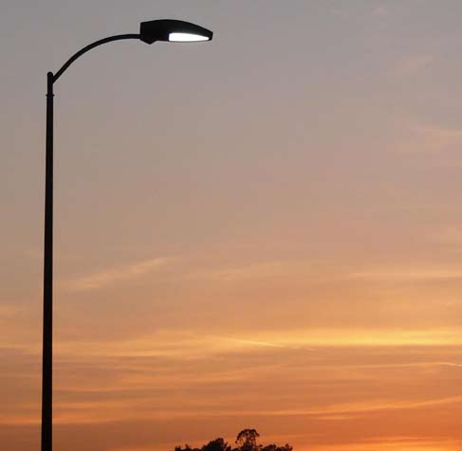
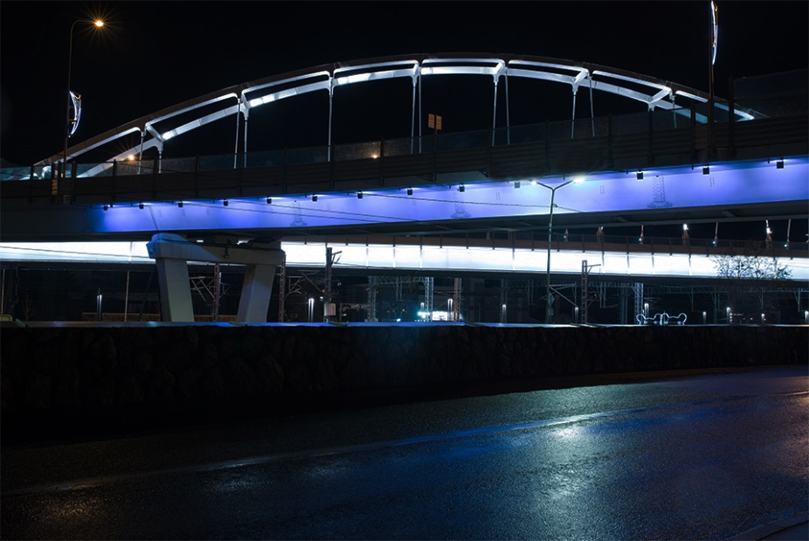
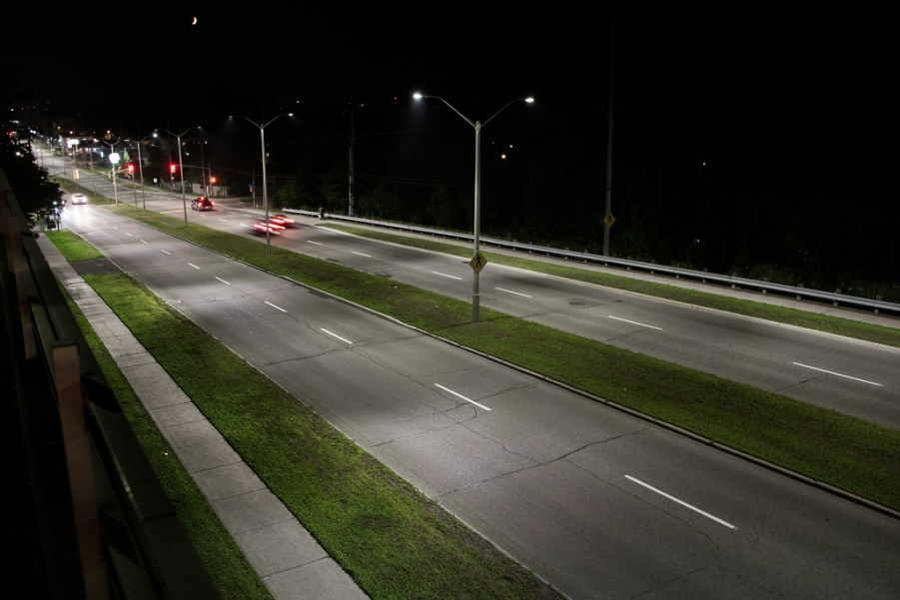
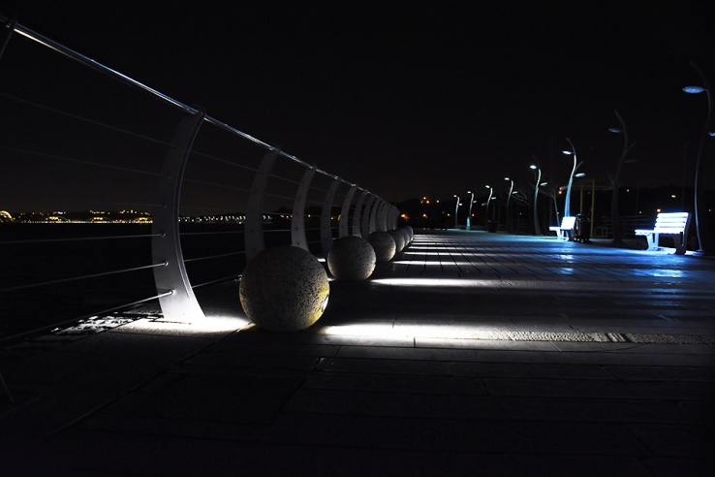
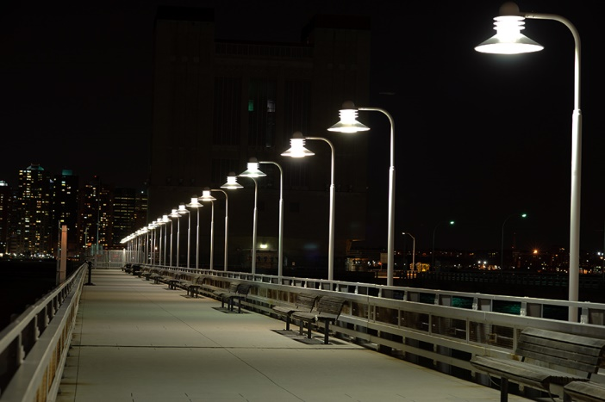
LED Lights are an Energy Efficient Option for Exterior Lighting

Slide 4

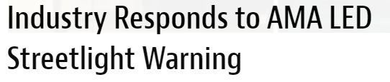
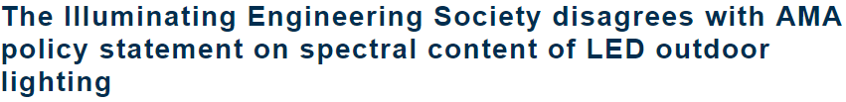
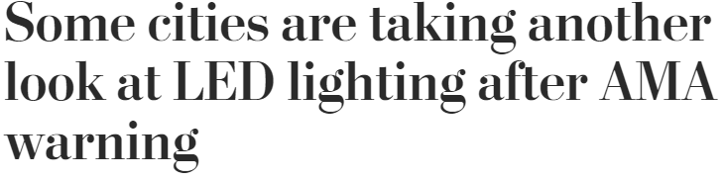
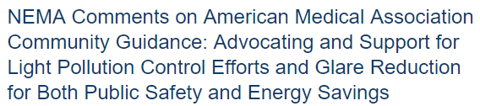
Public Debate on LEDs

Slide 5
Blue Light Hazard
Temporary or permanent loss of visual photoreceptor function following exposure to short-wavelength radiation on the retina.
Disability and Discomfort Glare
Disability Glare: reduction in visibility due to scattered light in the eye
Discomfort Glare: painful sensation when exposed to a bright light in field of view
Circadian Disruption – Melatonin Suppression
Disruption of circadian rhythm is known to contribute to a variety of maladies. CCT is too simple if a metric to determine melatonin suppression.
Notes:
Blue light hazard: High radiance, short wavelength light focused on the retina by the optics of the eye fro an extended duration has the potential to cause permanent damage to the retina. It is dependent on spectral distribution, optics, amount of exposure, and use case. Study by Lighting Research center shows blue light hazard weighted radiance for 3000K or 4000K LEDs is actually less than the BHWR for an incandescent filament. According to CIE/IEC 62471 standard, light sources of 3000-4000K become a hazard after staring directly into the light source for 33-43 minutes. This is highly improbable for motorist and pedestrians walking under outdoor light.
Disability and discomfort glare: disability glare depends upon the amount of scattered light from small particles in the eye, but these participles are large enough that scatter is independent of wavelength. It is dependent on how much light and the angle between the line of sight and the glare source. Spectrum does not matter. Discomfort glare increases with irradiance at the cornea and with reductions in the angular distance between the light source and the line f sight. The spectral composition of the light source also influences discomfort glare; sources with relative greater short wavelength content are seen as producing more discomfort for equal photopic illuminance at the cornea.
Melatonin: is a hormone that is produced at night and in darkness. Retinal exposure to light during nighttime can suppress melatonin synthesis. However, humans have a high threshold to retinal light exposure for suppressing melatonin at night. The amount and the duration of exposure need to be specified before it can be stated that LED sources affect melatonin suppression at night.
Circadian disruption: Until more is known about the effects of long-wavelength light exposure (amount, spectrum, duration) on circadian disruption, it is inappropriate to single out short-wavelength radiation from LEDs as the causing factor for this.

Slide 6
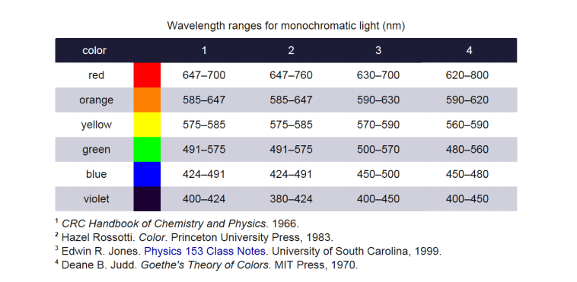
Blue Light Hazard
The safety of LED lighting with regard to human health has occasionally been the subject of scrutiny. One such concern is photoretinitis—photochemical damage to the retina—which can result from too much exposure to violet and blue light. This is known as blue light hazard. The risk of blue light hazard is sometimes associated with LEDs, even though LEDs that emit white light do not contain significantly more blue than any other source at the same color temperature
There is no single, discrete definition of blue light. Light colors vary along a continuum.
The associated “health” and other impacts under discussion are caused by particular wavelengths of light, not by color.

Slide 7
Disability & Discomfort Glare
Glare is a visual sensation caused by excessive and uncontrolled brightness. It can be disabling or simply uncomfortable. It is subjective, and sensitivity to glare can vary widely. Disability glare is the reduction in visibility caused by intense light sources in the field of view, while discomfort glare is the sensation of annoyance or even pain induced by overly bright sources (Rea 2000). Reducing glare is an effective way to improve the lighting.

Slide 8
Circadian Disruption – Melatonin Supersession
Melatonin suppression at night is not synonymous with circadian disruption. Staying awake in dim light at night or limited exposure to light during the day can also be disruptive to physiology and behavior, even though there is no effect of the light on melatonin concentrations.
These disruptive social‐behavioral effects may or may not be associated with nocturnal melatonin suppression. Much less is known about the spectral and absolute sensitivities to light as they affect circadian disruption.

Slide 9
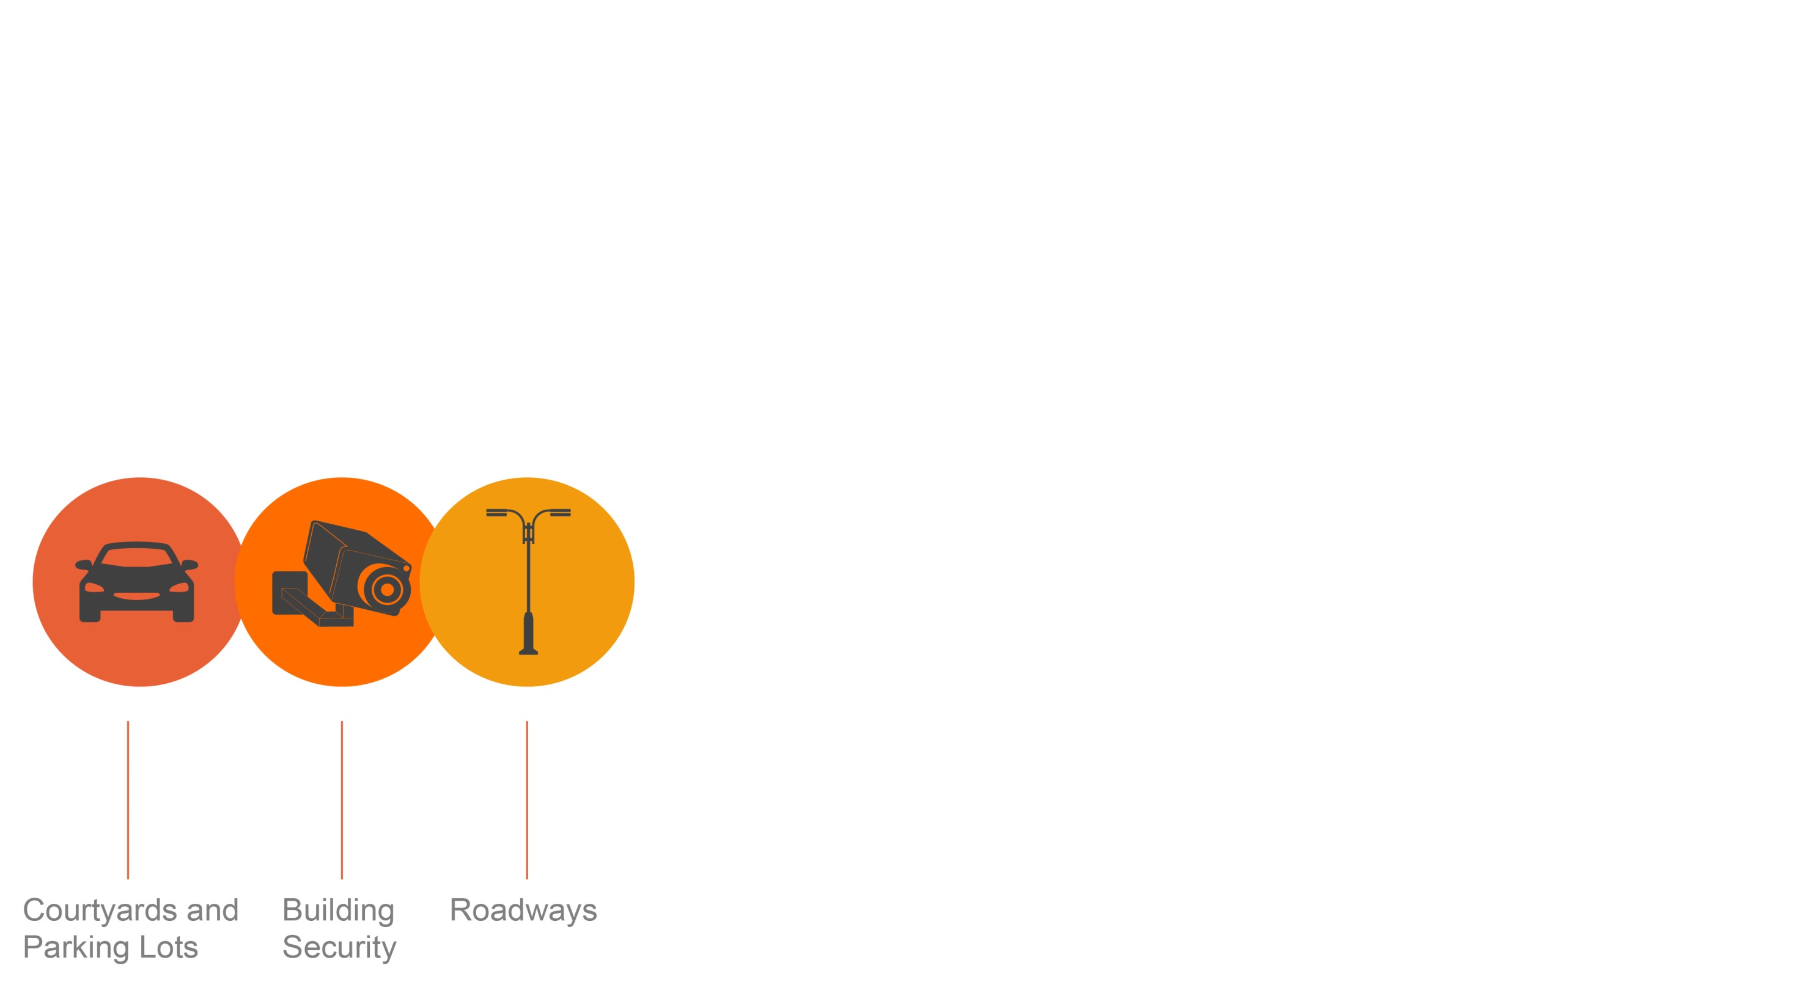
LEDs are Versatile
LED lighting systems are essential to use when properly designed and installed. The designs of these lights consider public safety, light distribution and quality, glare control, costs, maintenance and color.
The characteristics of these systems provide versatility and end-user choice. Light distribution, color temperature, and glare control are now available in outdoor lighting with LED technology.
The American Medical Association (AMA, Department of Energy (DOE) and lighting industry agree that LED lights are energy efficient. Unfortunately, the AMA policy recommends restrictions on the color of LED lighting for exterior application. These restrictions on exterior lighting are unfounded and unsuitable. The color of light is not a one-size-fits-all.

Slide 10
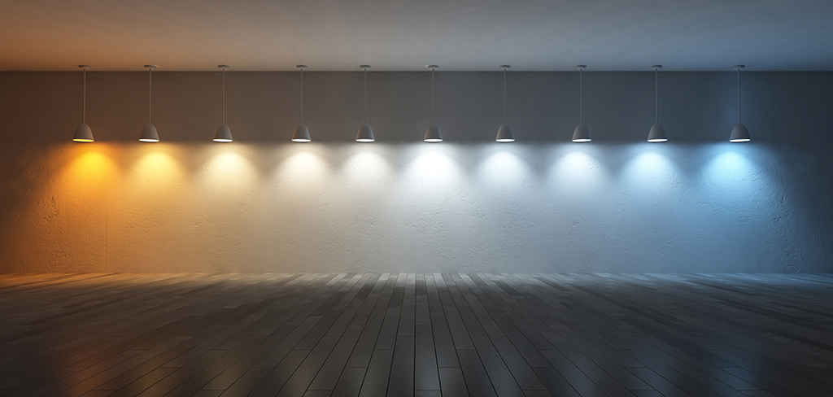
Light Source Color
Warm vs Cool
AMA recommendation limits blue spectral content to minimize hormonal disruption
This is better seen by the human eye at night
Improved reaction time
Enhanced safety and security
Lower light levels can be used
4100K matches moonlight

Slide 11
Calculating Circadian Stimulus (CS)
When specifying lighting for the circadian system, it is important to consider light level, spectrum (color), timing and duration of exposure, and photic history (previous light exposures). An important first step in establishing whether a lighting system will deliver a prescribed amount of CS is to determine the spectral irradiance distribution of the light incident at the cornea.
The Lighting Research Center recommends to design for vertical (≈ corneal) illuminance at the eye, not just horizontal illuminance on the work plane.
Reference: http://www.lrc.rpi.edu/resources/newsroom/LDA_CircadianStimulus_Oct2016.pdf

Slide 12
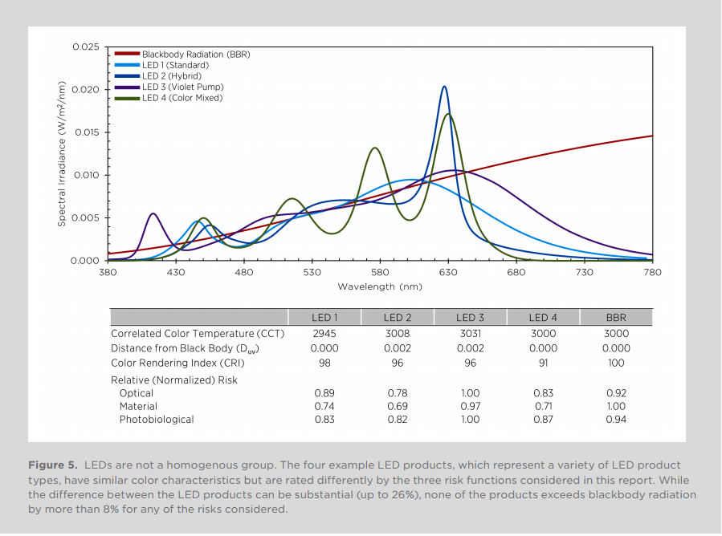
LED Lights Result in No Greater Exposure than Incandescent (BBR)
BBR (Incandescent)

Slide 13
What does DOE say?
The Department of Energy (DOE) says there is nothing inherently dangerous about LED lighting and that it should be used with the same caution with which we use any other technology.
LED lighting systems are dimmable – providing only the level of illumination needed at any given time – which is nearly impossible for conventional lighting.
DOE says that LEDs offer a high degree of control over the pattern and evenness of light on the ground compared to conventional lighting.
LED lighting is widely available with various levels of Correlated Color Temperature (CCT), which is important depending on the application. Research has also confirmed that visual acuity and reaction time is improved with sources that have relatively higher ‘blue’ (short wavelength) content.
https://energy.gov/eere/ssl/articles/get-facts-led-street-lighting

Slide 14
What does IES say?
The Illuminating Engineering Society issued a position statement disagreeing with the AMA policy statements regarding blue light and CCT restrictions.
IES indicates AMA has not provided sufficient evidence to substantiate these statements. IES further states that a more comprehensive analysis of the public health impacts of outdoor and roadway lighting should be considered prior to adopting policies that could have a negative effect on the safety of drivers and pedestrians.
https://www.ies.org/policy/position-statements/ies-board-position-on-ama-csaph-report-2-a-16-human-and-environmental-effects-of-light-emitting-diode-led-community-lighting/

Slide 15
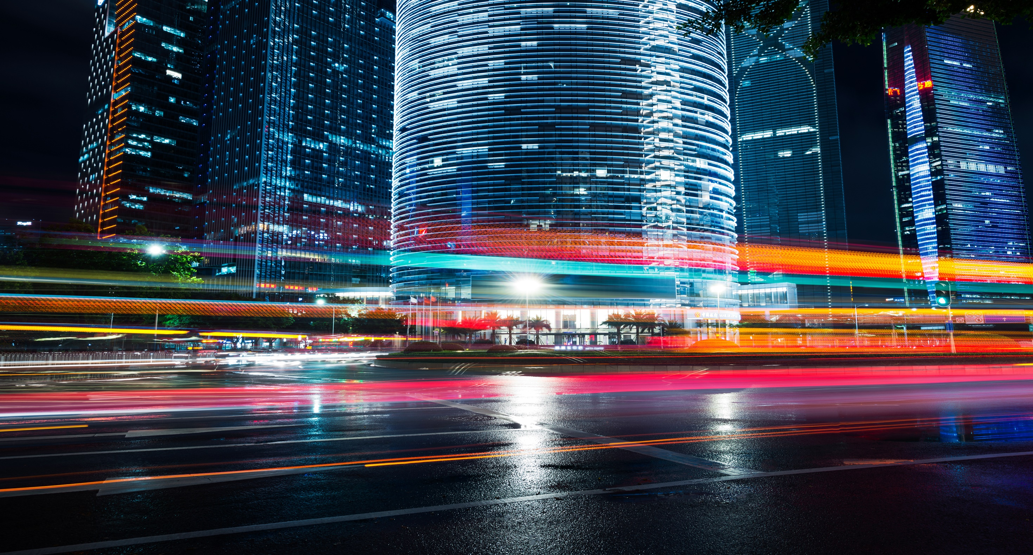
Engineered lighting designs consider a range of key variables unique to a given environment. The design and installation of exterior lighting should fit the needs of the application and location. Restricting exterior lighting to only warm color tones may pose a safety risk in certain environments.

Slide 16
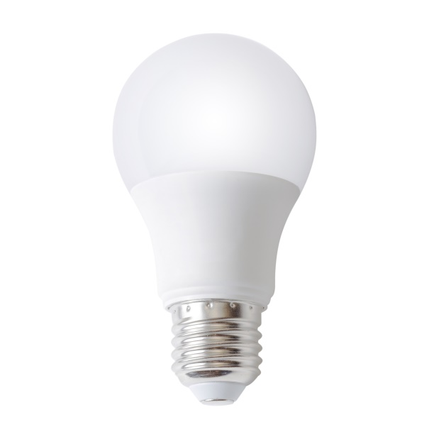
Industry agrees with these AMA LED Recommendations
-Use lighting controls: motion sensing, dimming, and stepped power switching to prevent unnecessary light
-Restrict illumination to the task or target area
E.g., Shield the light to curtail up-light, glare and light trespass
-Design for minimum required light levels and energy consumption
Consult a lighting professional to evaluate the application requirements to assist in selecting the right light for the job.

Slide 17
Remember…
Outdoor LED lights come in a range of colors. Choosing the correct spectral content will optimize safety and visibility.
For a safe and secure environment,
use appropriate metrics and select the right light.

