Slide 1
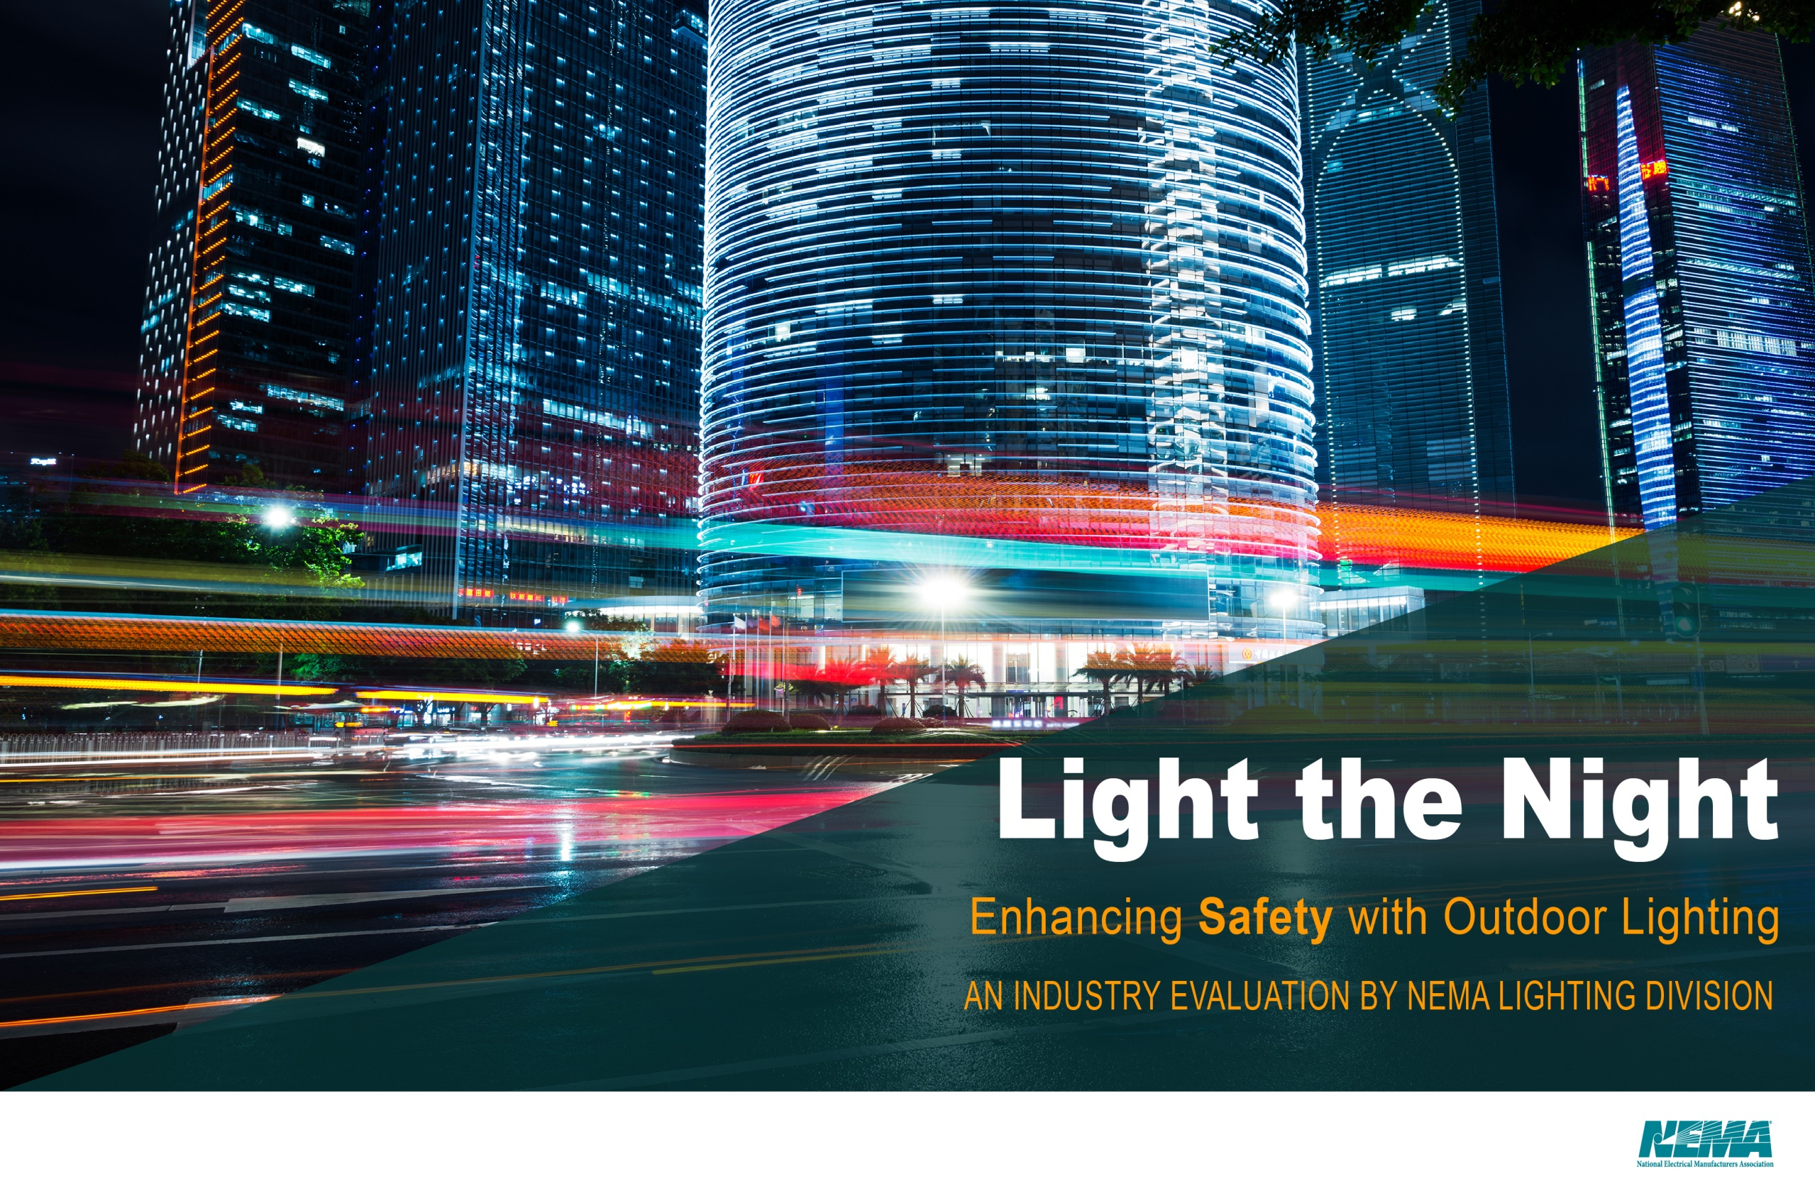

Slide 2
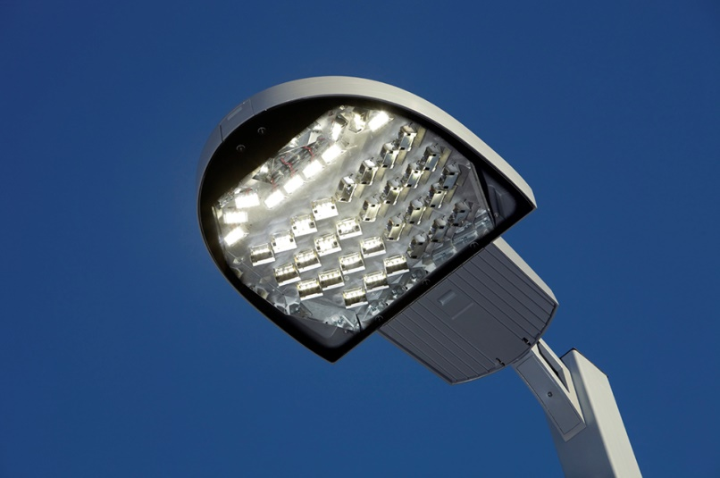
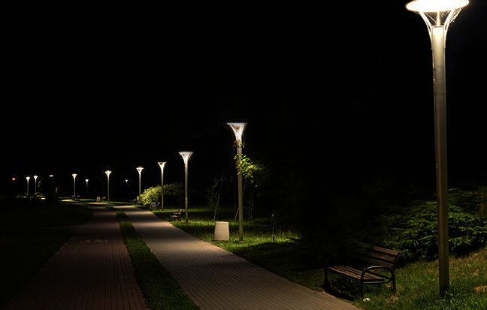
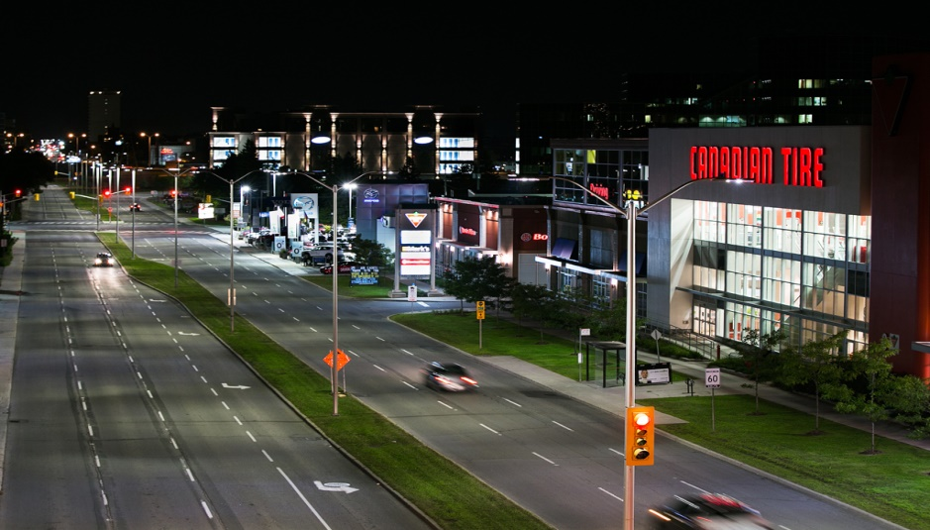
Proper lighting is essential…
…for the safety of buildings and surrounding areas
Notes:
*new photos for two on right – those are indoor lights

Slide 3
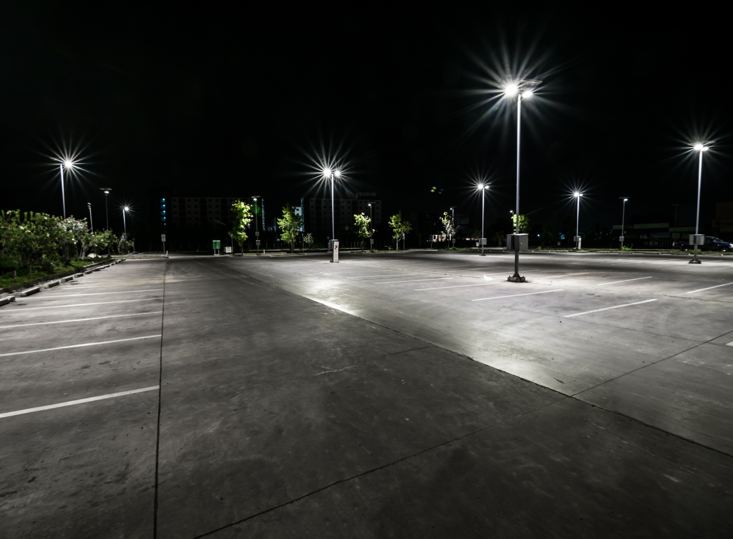
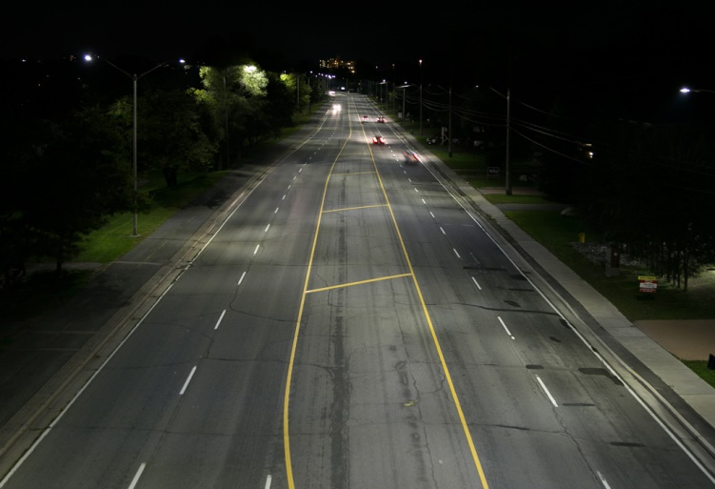
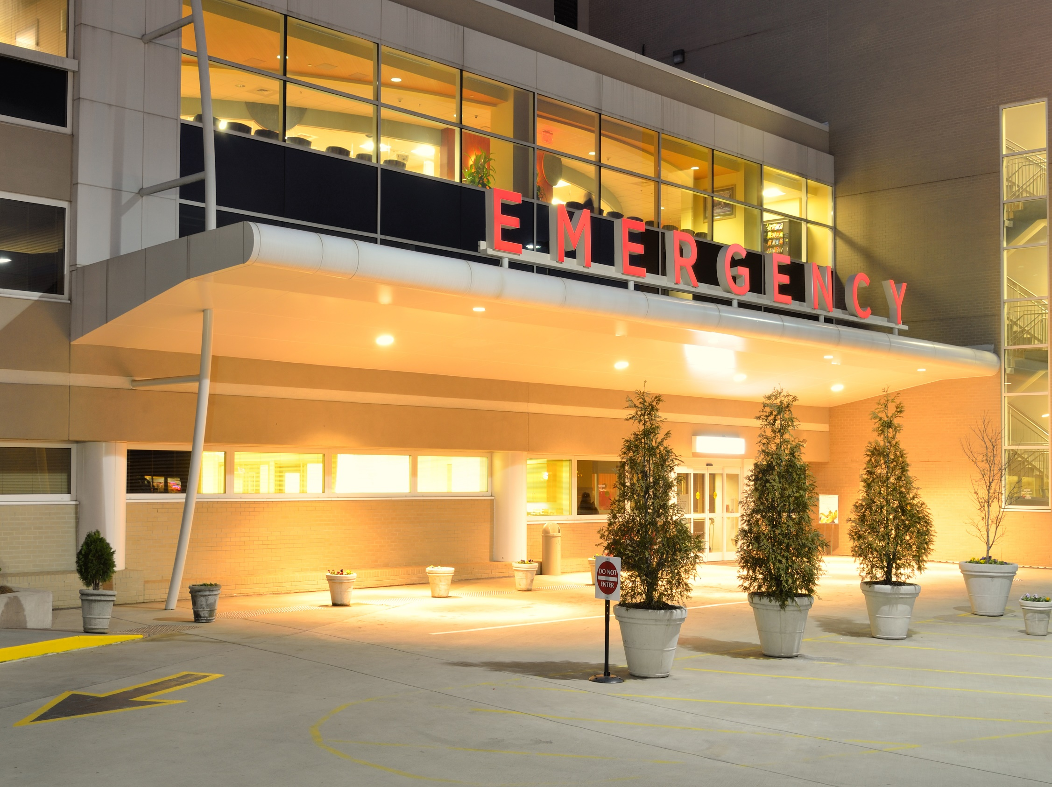
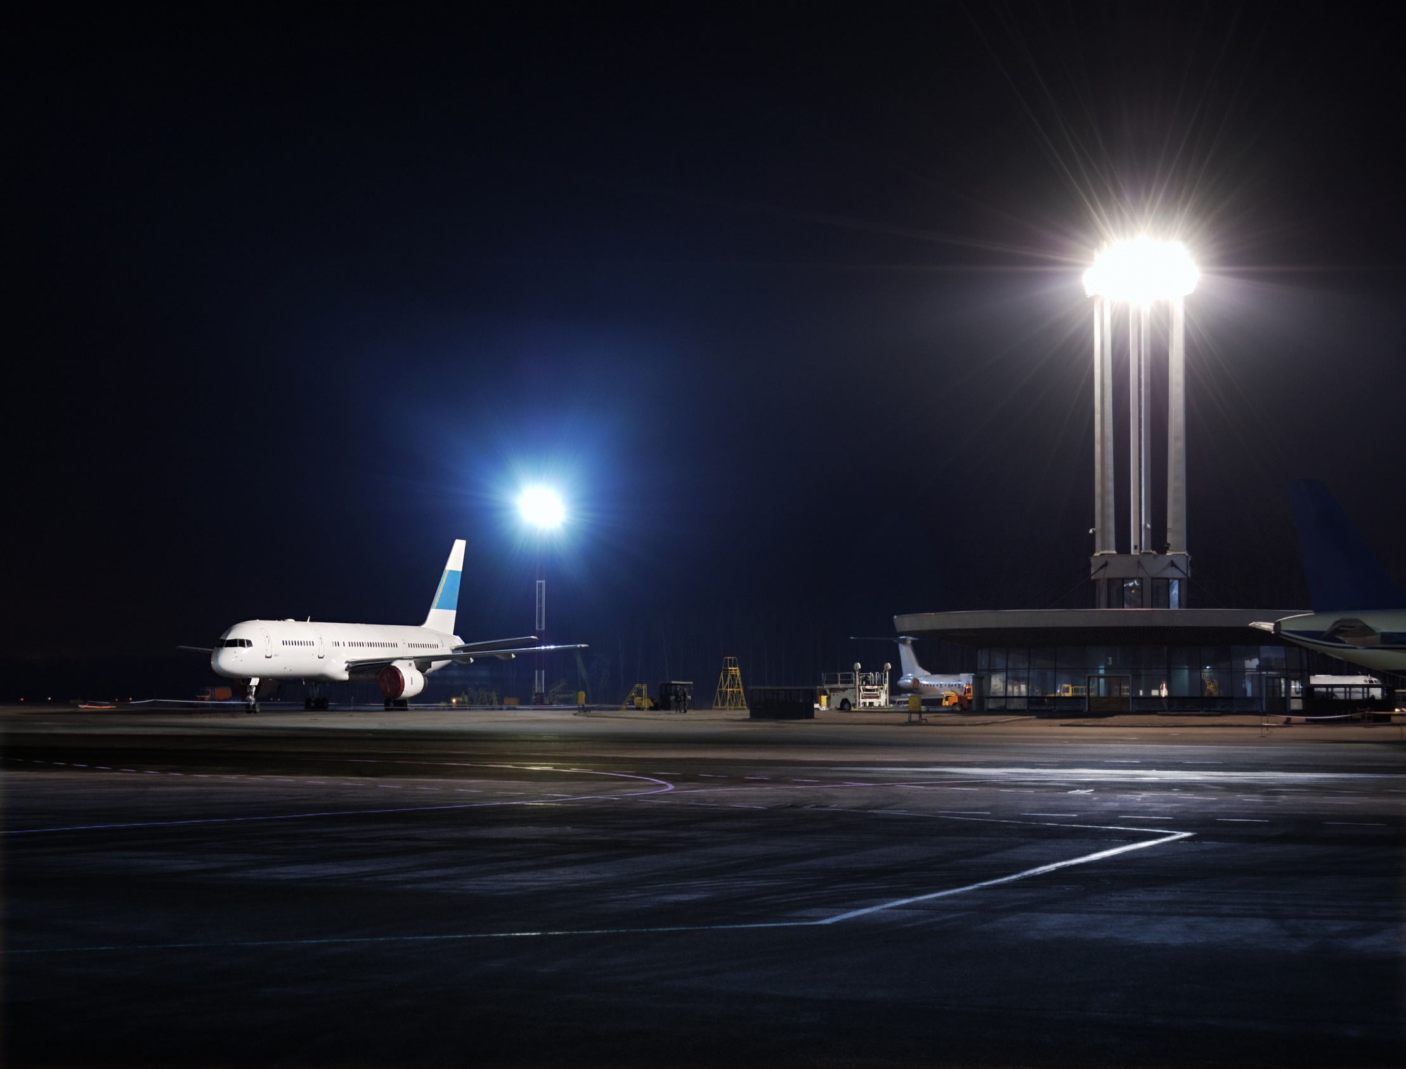
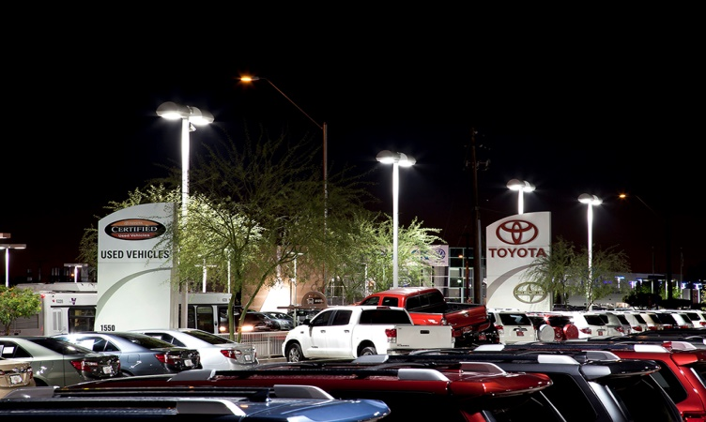
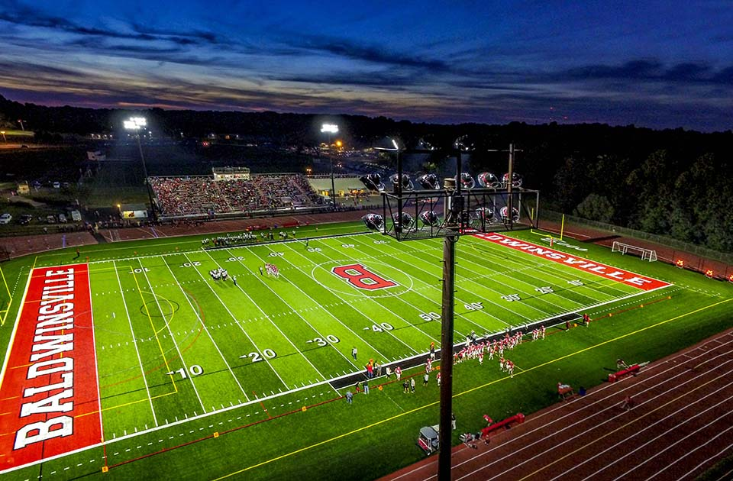
LED Lights are an Energy Efficient Option for…
Commercial Properties
Including:
Residential Neighborhoods
Interstate Commerce
Outdoor Recreation
Parking Lots
Airports
Hospitals
Notes:
Sample photos

Slide 4

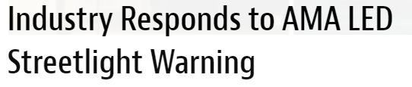
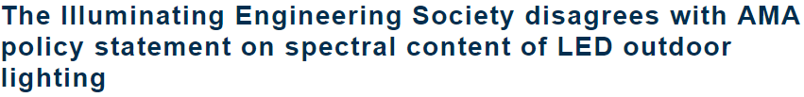
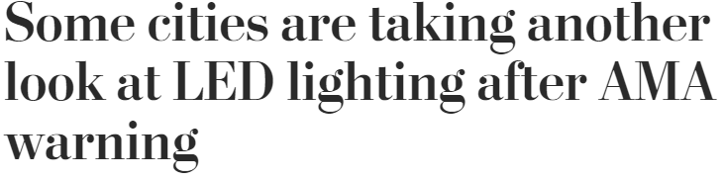
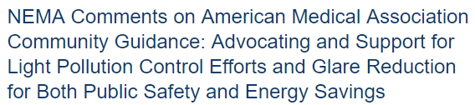
Public Debate on LEDs
Public Debate on LEDs

Slide 5
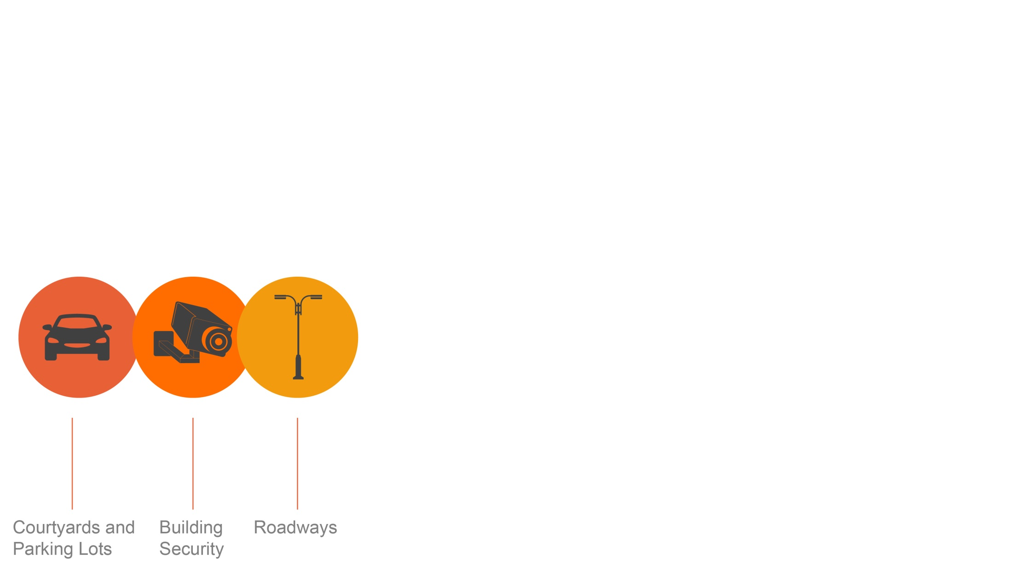
LEDs are Versatile
LED lighting systems are essential to use when properly designed and installed. The designs of these lights consider public safety, light distribution and quality, glare control, costs, maintenance and color.
The characteristics of these systems provide versatility and end-user choice. Light distribution, color temperature, and glare control are now available in outdoor lighting with LED technology.
The American Medical Association (AMA, Department of Energy (DOE) and lighting industry agree that LED lights are energy efficient. Unfortunately, the AMA policy recommends restrictions on the color of LED lighting for exterior application. These restrictions on exterior lighting are unfounded and unsuitable. The color of light should not be one-size-fits-all.

Slide 6
Blue Light Hazard
Temporary or permanent loss of visual photoreceptor function following exposure to short-wavelength radiation on the retina.
Disability and Discomfort Glare
Disability Glare: reduction in visibility due to scattered light in the eye
Discomfort Glare: painful sensation when exposed to a bright light in field of view
Circadian Disruption – Melatonin Suppression
Disruption of circadian rhythm is known to contribute to a variety of maladies. CCT is too simple if a metric to determine melatonin suppression.
Notes:
Blue light hazard: High radiance, short wavelength light focused on the retina by the optics of the eye fro an extended duration has the potential to cause permanent damage to the retina. It is dependent on spectral distribution, optics, amount of exposure, and use case. Study by Lighting Research center shows blue light hazard weighted radiance for 3000K or 4000K LEDs is actually less than the BHWR for an incandescent filament. According to CIE/IEC 62471 standard, light sources of 3000-4000K become a hazard after staring directly into the light source for 33-43 minutes. This is highly improbable for motorist and pedestrians walking under outdoor light.
Disability and discomfort glare: disability glare depends upon the amount of scattered light from small particles in the eye, but these participles are large enough that scatter is independent of wavelength. It is dependent on how much light and the angle between the line of sight and the glare source. Spectrum does not matter. Discomfort glare increases with irradiance at the cornea and with reductions in the angular distance between the light source and the line f sight. The spectral composition of the light source also influences discomfort glare; sources with relative greater short wavelength content are seen as producing more discomfort for equal photopic illuminance at the cornea.
Melatonin: is a hormone that is produced at night and in darkness. Retinal exposure to light during nighttime can suppress melatonin synthesis. However, humans have a high threshold to retinal light exposure for suppressing melatonin at night. The amount and the duration of exposure need to be specified before it can be stated that LED sources affect melatonin suppression at night.
Circadian disruption: Until more is known about the effects of long-wavelength light exposure (amount, spectrum, duration) on circadian disruption, it is inappropriate to single out short-wavelength radiation from LEDs as the causing factor for this.

Slide 7
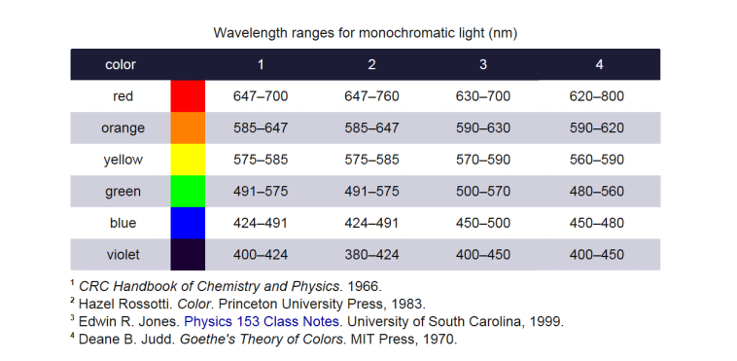
Blue Light Hazard
The safety of LED lighting with regard to human health has occasionally been the subject of scrutiny.
There is no single, discrete definition of blue light. Light colors vary along a continuum.
The associated “health” and other impacts under discussion are caused by particular wavelengths of light, not by color.
Notes:
One such concern is photoretinitis, which can result from too much exposure to violet and blue light. The risk of blue light hazard is sometimes associated with LEDs, even though LEDs that emit white light do not contain significantly more blue than any other source at the same color temperature

Slide 8
Disability & Discomfort Glare
Glare is a visual sensation caused by excessive and uncontrolled brightness.
Disability glare is the reduction in visibility caused by intense light sources in the field of view, while discomfort glare is the sensation of annoyance or even pain induced by overly bright sources.
Notes:
It can be disabling or simply uncomfortable. It is subjective, and sensitivity to glare can vary widely.
Reducing glare is an effective way to improve the lighting.

Slide 9
Circadian Disruption – Melatonin Suppression
Melatonin suppression at night is not synonymous with circadian disruption.
These disruptive social‐behavioral effects may or may not be associated with nocturnal melatonin suppression. Much less is known about the spectral and absolute sensitivities to light as they affect circadian disruption.
Notes:
Staying awake in dim light at night or limited exposure to light during the day can also be disruptive to physiology and behavior, even though there is no effect of the light on melatonin concentrations.

Slide 10
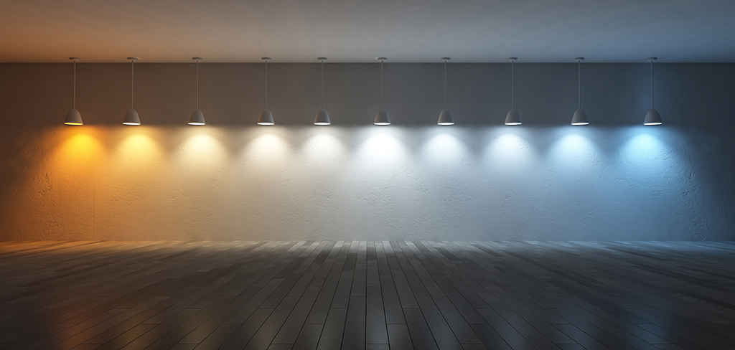
Light Source Color
Warm vs Cool
This is better seen by the human eye at night
Improved reaction time
Enhanced safety and security
More energy efficient
4100K matches moonlight
AMA recommendation limits blue content to minimize hormonal disruption

Slide 11
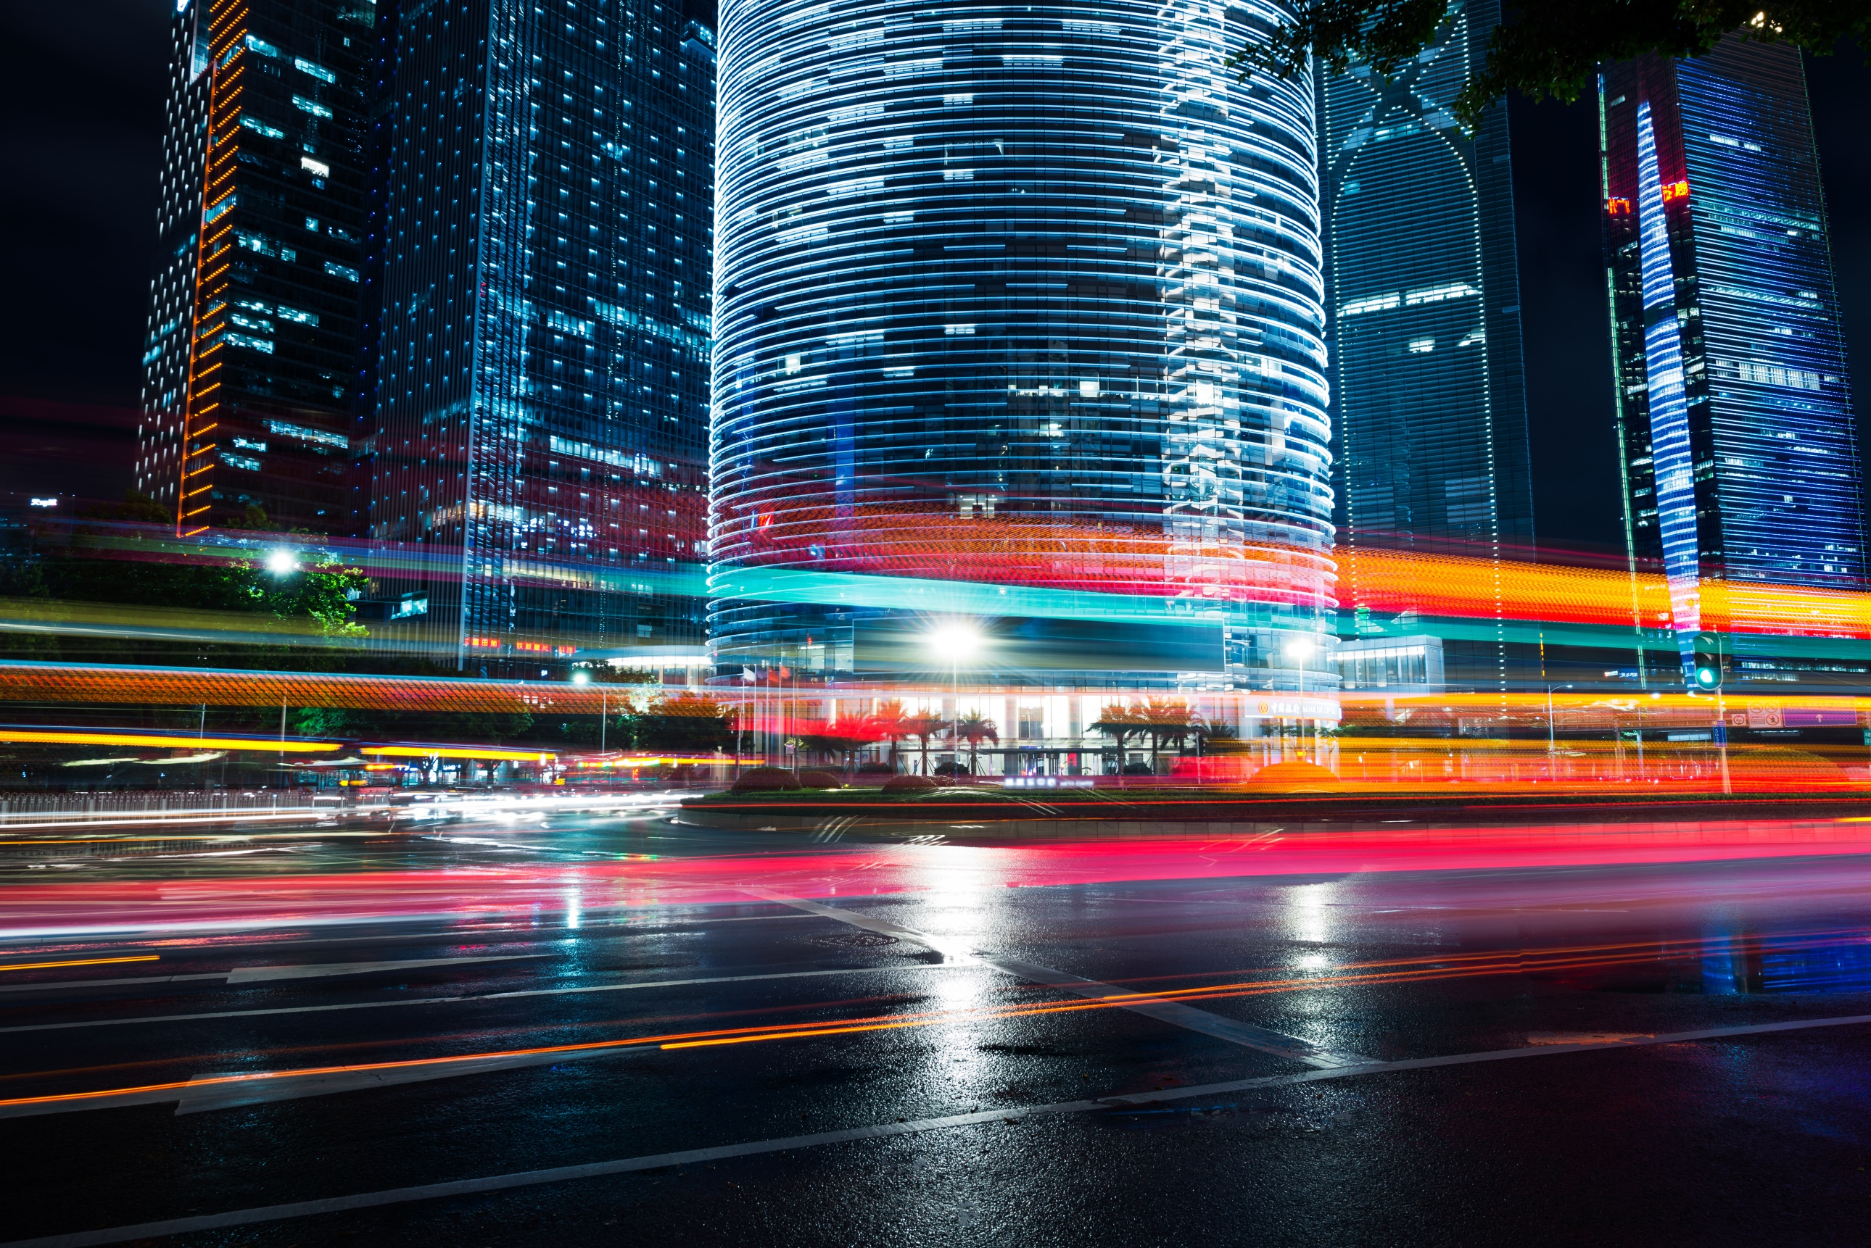
Engineered lighting designs consider a range of key variables unique to a given environment. The design and installation of exterior lighting should fit the needs of the application and location. Restricting exterior lighting to only warm color light may pose a safety risk in certain environments.
Notes:
FIX slide

Slide 12
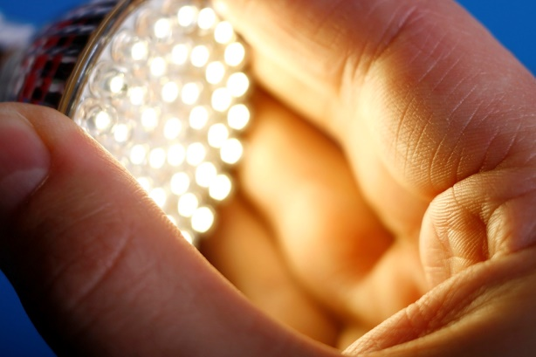
Industry agrees with these AMA LED Recommendations
-Use lighting controls: motion sensing, dimming, and stepped power switching
-Restrict illumination to the task or target area
E.g., shield the light to curtail excessive up-light, glare and light trespass
-Design for minimum required light levels and energy consumption
Consult a lighting professional to evaluate the application requirements to assist in selecting the right light for the job.

Slide 13
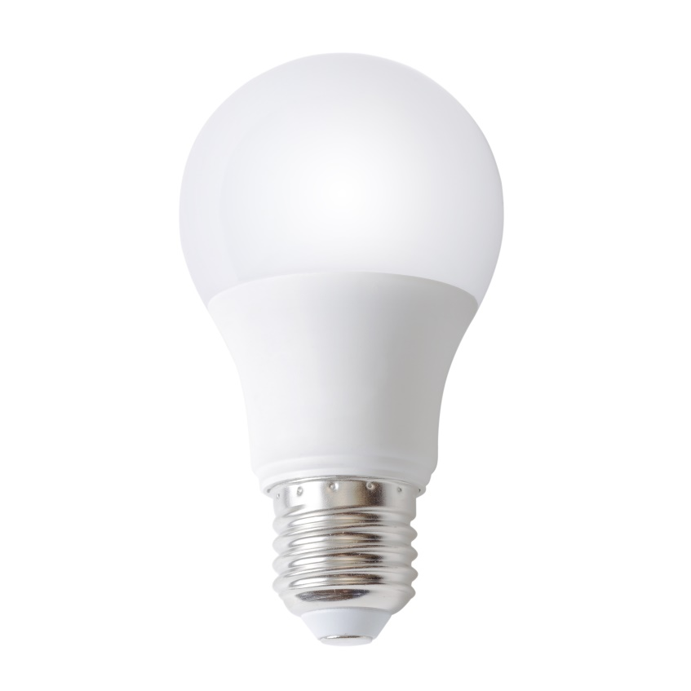
Remember…
The right light – in the right place, at the right time, for the right situation – can positively impact public safety and livability while also offering energy efficiency and savings on maintenance.

