Slide 1
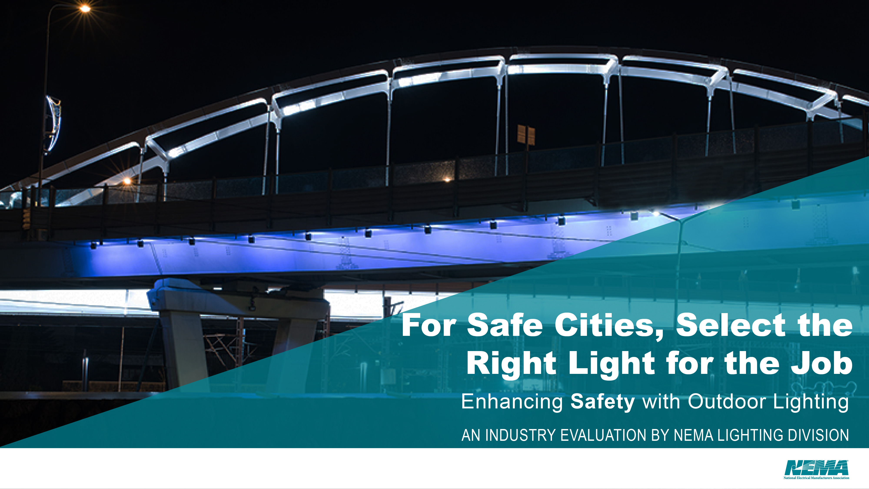


Slide 2
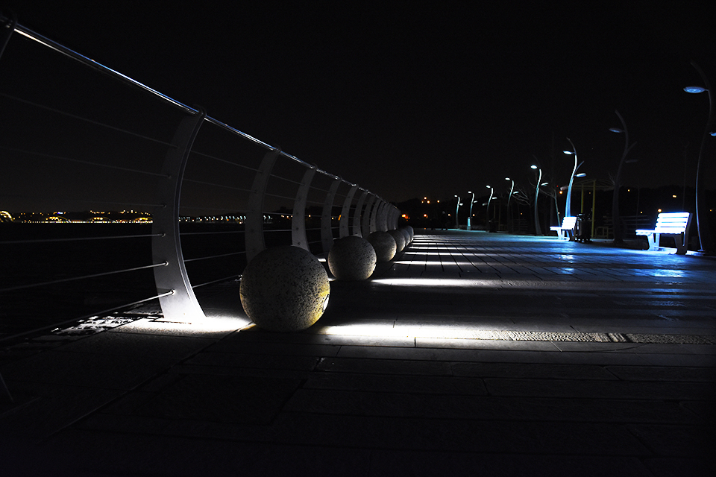
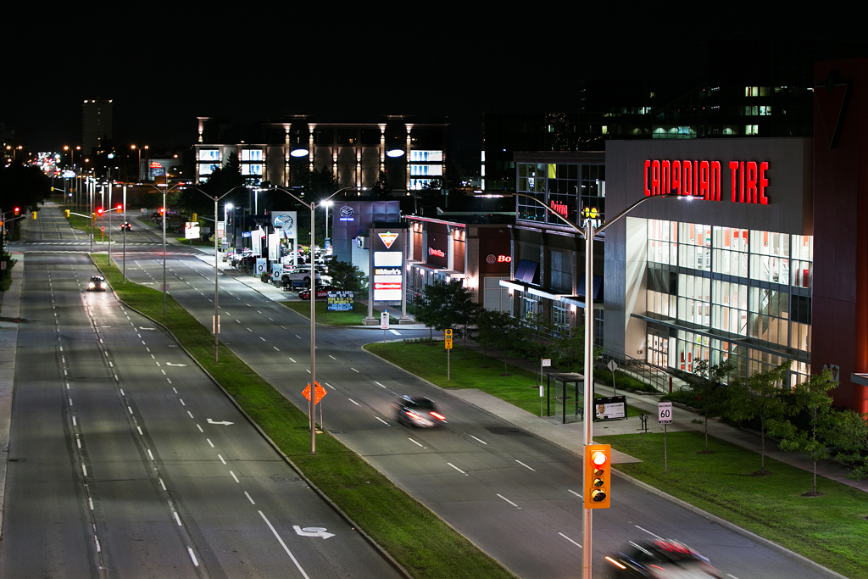
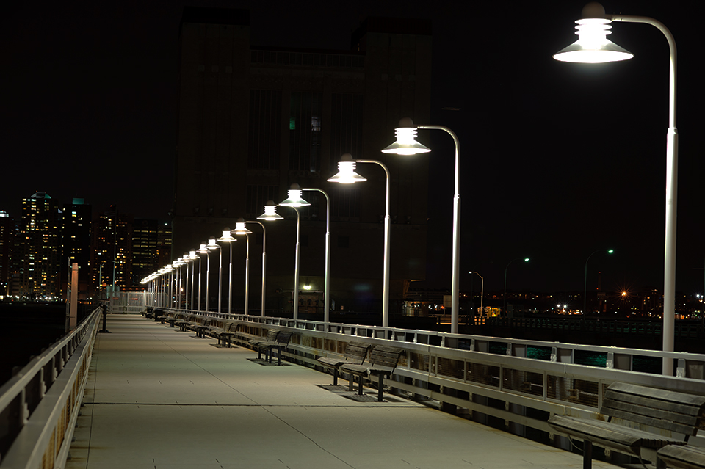
Proper lighting is essential for safety and livability in your city

Slide 3
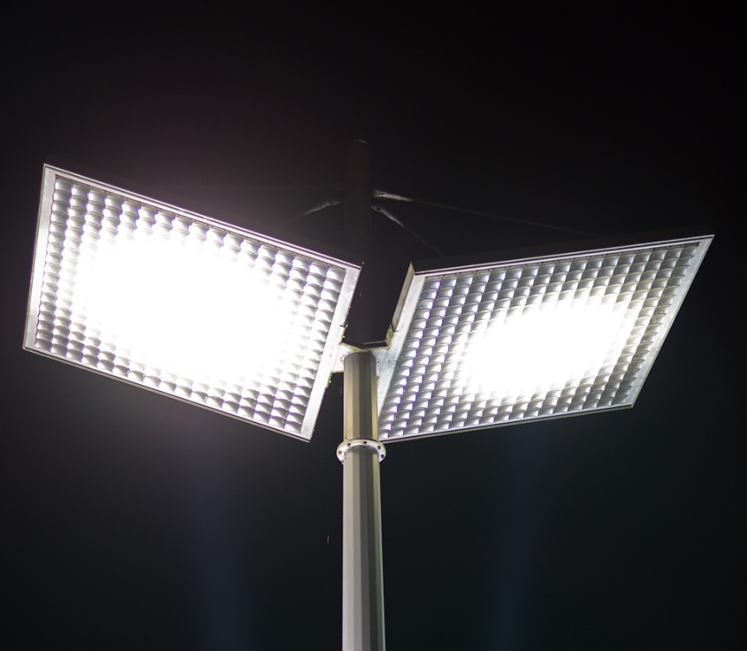
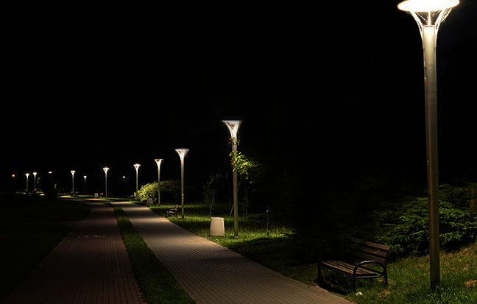
Outdoor LED lights are the sustainable and economical choice for…
Roads and Highways
Pedestrian Paths
Parking Lots
Parks and Playgrounds
Bridges

Slide 4

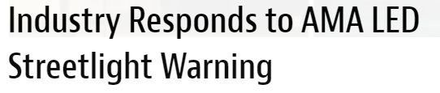
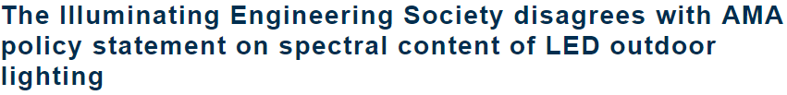
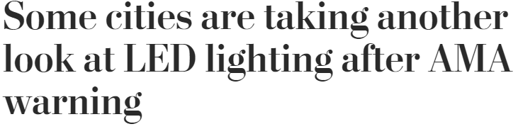
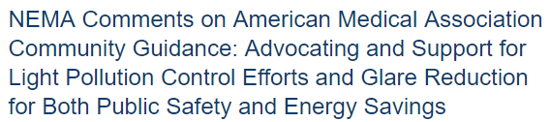
Public Debate on LEDs

Slide 5

  Not all LED lights are created equal…
LED lighting systems are essential to use and must be properly designed and installed. The designs of these lights consider public safety, light distribution and quality, glare control, costs, maintenance and color.
The American Medical Association (AMA), Department of Energy (DOE) and lighting industry agree that LED lights are energy efficient.
Unfortunately, the AMA policy recommends restrictions on the color of LED lighting for outdoor application. The color of light is not a one-size-fits-all.

Slide 6
Blue Light Hazard
Temporary or permanent loss of visual photoreceptor function following exposure to short-wavelength radiation on the retina.
Disability and Discomfort Glare
Disability Glare: reduction in visibility due to scattered light in the eye
Discomfort Glare: painful sensation when exposed to a bright light in field of view
Circadian Disruption – Melatonin Suppression
Disruption of circadian rhythm is known to contribute to a variety of maladies. CCT is too simple if a metric to determine melatonin suppression.

Slide 7
Blue Light Hazard
A recent study by the Lighting Research Center (LRC) show that in the majority of use cases, LEDs do not exhibit greater risk for blue-light hazard than other light sources, including incandescent.
Notes:
Blue light hazard: High radiance, short wavelength light focused on the retina by the optics of the eye fro an extended duration has the potential to cause permanent damage to the retina. It is dependent on spectral distribution, optics, amount of exposure, and use case. Study by Lighting Research center shows blue light hazard weighted radiance for 3000K or 4000K LEDs is actually less than the BHWR for an incandescent filament. According to CIE/IEC 62471 standard, light sources of 3000-4000K become a hazard after staring directly into the light source for 33-43 minutes. This is highly improbable for motorist and pedestrians walking under outdoor light.
LEDs present no concerns for blue-light hazard over other common light sources in typical use cases because our natural photophobic responses to bright light (squinting, averting gaze).
https://www.tandfonline.com/doi/abs/10.1080/10803548.2017.1375172?journalCode=tose20

Slide 8
Disability & Discomfort Glare
From the LRC:
Glare is a visual sensation caused by excessive and uncontrolled brightness. It can be disabling or simply uncomfortable. It is subjective, and sensitivity to glare can vary widely.
Disability glare is the reduction in visibility caused by intense light sources in the field of view, while discomfort glare is the sensation of annoyance or even pain induced by overly bright sources
Notes:
Disability and discomfort glare: disability glare depends upon the amount of scattered light from small particles in the eye, but these participles are large enough that scatter is independent of wavelength. It is dependent on how much light and the angle between the line of sight and the glare source. Spectrum does not matter. Discomfort glare increases with irradiance at the cornea and with reductions in the angular distance between the light source and the line of sight. The spectral composition of the light source also influences discomfort glare; sources with relative greater short wavelength content are seen as producing more discomfort for equal photopic illuminance at the cornea.

Slide 9
Circadian Disruption –
Melatonin Suppression
Circadian rhythms are generated and regulated by a biological clock in the brain. There are limited studies about circadian disruption as it relates specifically to light. As IES stated, measuring the Correlated Color Temperature (CCT) is inadequate for evaluating possible health outcomes.
Notes:
Melatonin: is a hormone that is produced at night and in darkness. Retinal exposure to light during nighttime can suppress melatonin synthesis. However, humans have a high threshold to retinal light exposure for suppressing melatonin at night. The amount and the duration of exposure need to be specified before it can be stated that LED sources affect melatonin suppression at night.
Circadian disruption: Until more is known about the effects of long-wavelength light exposure (amount, spectrum, duration) on circadian disruption, it is inappropriate to single out short-wavelength radiation from LEDs as the causing factor for this.

Slide 10
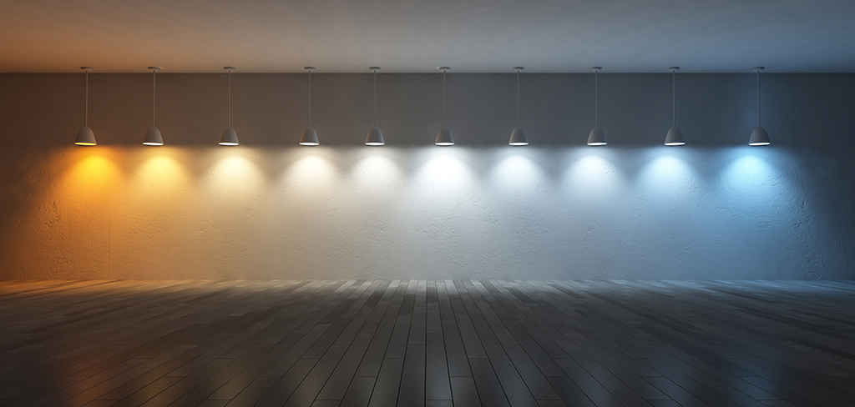
This is better seen by the human eye at night
  Improved reaction time
  Enhanced safety and security
  More energy efficient
  4100K matches moonlight
Light Source Color
Warm vs Cool
AMA recommendation limits blue content to minimize hormonal disruption

Slide 11
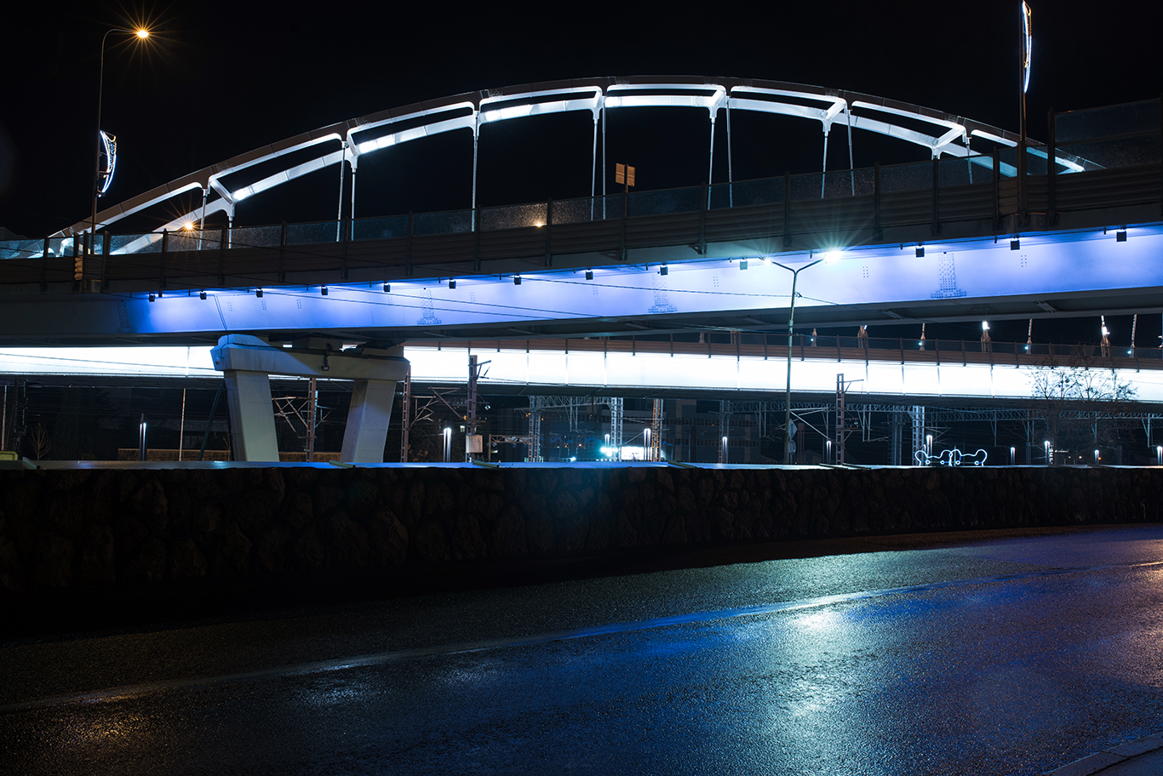
Engineered lighting designs consider a range of key variables unique to a given environment. The design and installation of exterior lighting should fit the needs of any space. Restricting exterior lighting to only warm color tones may pose a safety risk in certain environments.
Notes:
FIX slide

Slide 12
What does DOE say?
The Department of Energy (DOE) says there is nothing inherently dangerous about LED lighting and that it should be used with the same caution with which we use any other technology.
LED lighting systems are dimmable – providing just the level of illumination needed at any given time – which is not practical for conventional lighting.
DOE says that LEDs offer a high degree of control over the pattern and evenness of light on the ground compared to conventional lighting.
LED lights are widely available with various levels of Correlated Color Temperature (CCT), which is important depending on the application. Research has also confirmed that visual acuity and reaction time is improved with sources that have higher ‘blue’ (short wavelength) content.
https://energy.gov/eere/ssl/articles/get-facts-led-street-lighting

Slide 13
What does IES say?
The Illuminating Engineering Society issued a position statement disagreeing with the AMA policy statements regarding blue light and CCT restrictions.
IES indicates AMA has not provided sufficient evidence to substantiate these statements. IES further states that a more comprehensive analysis of the public health impacts of outdoor and roadway lighting should be considered prior to adopting policies that could have a negative effect on the safety of drivers and pedestrians.
https://www.ies.org/policy/position-statements/ies-board-position-on-ama-csaph-report-2-a-16-human-and-environmental-effects-of-light-emitting-diode-led-community-lighting/

Slide 14
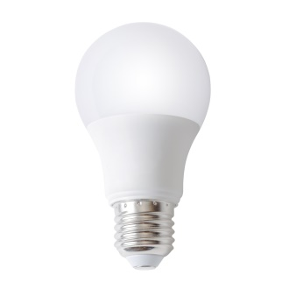
Industry agrees with these AMA LED Recommendations
-Use lighting controls: motion sensing, dimming, stepped power switching
-Restrict illumination to the task or target area
  E.g., shield the light to curtail excessive up-light, glare and light trespass
-Design for minimum required light levels and energy consumption
Consult a lighting professional to evaluate the application requirements to assist in selecting the right light for the job.

Slide 15
Remember…
The right light – in the right place, at the right time, for the right situation – can positively impact public safety and livability, while also offering energy efficiency and savings on maintenance.

