Slide 1

Leveling the Regulatory Playing Field for Small Businesses
Presented to:
The National Electrical Manufacturers Association
by
C. Natalie Lui Duncan
Deputy National Ombudsman
November 13, 2017

Slide 2
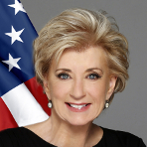
“The Office of the National Ombudsman helps lift the burden of regulatory compliance off the backs of entrepreneurs, enabling them to keep their focus
where it belongs—on their businesses.”
Linda E. McMahon
Administrator
U.S. Small Business Administration

Slide 3
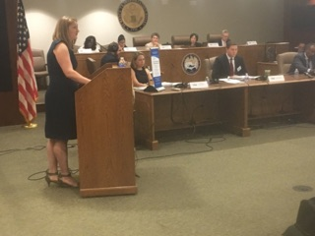
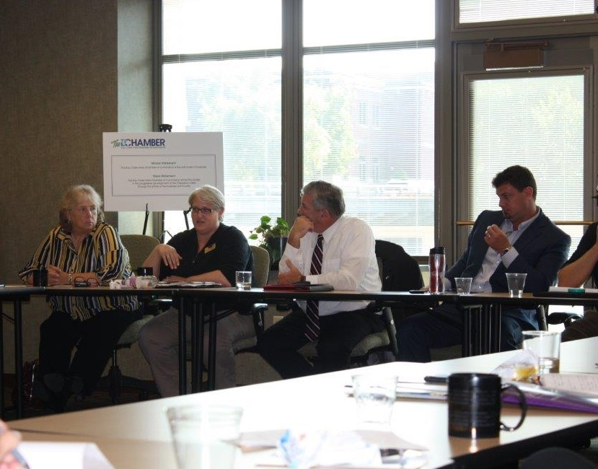
Mission
The SBA Office of the National Ombudsman (ONO) assists small businesses when they experience excessive or unfair Federal regulatory enforcement actions, such as repetitive audits or investigations, excessive fines, penalties, threats, retaliation, or other unfair enforcement action by a Federal agency
Its establishment was authorized by the Small Business Regulatory Enforcement Fairness Act of 1996 (SBREFA)
2017 National Regulatory Enforcement
Fairness Hearing, Washington DC
Region V Regulatory Enforcement Fairness
Roundtable, Eau Claire, WI

Slide 4
Core Functions
Solicits comments from small businesses
Acts as a troubleshooter between small businesses and Federal agencies
Serves as a voice for small businesses
Conducts public hearings, roundtables, and forums
Rates Federal agencies on their responsiveness to small business regulatory concerns
Raises small business concerns to Congress

Slide 5
Working for Your Small Business
ONO saves time and money for small business owners by helping to:
Obtain compliance assistance and clarify compliance questions
Reduce fines and penalties
Resolve regulatory enforcement matters
Connect small businesses with government officials

Slide 6
Key Regulatory Fairness Levers
Issue Resolution: Comment & Review Process
Accountability: Annual Agency Ratings
Outreach: Local Roundtables & Hearings
Regional Conduits: Regulatory Fairness Boards

Slide 7
Issue Resolution:
Comment and Review Process
Impartial channel to report concerns with regulatory compliance and enforcement involving Federal agencies:
  Confidential
  Neutral liaison between small business and Federal regulators
  Independent, high-level agency review and response addressed to specific concerns

Slide 8
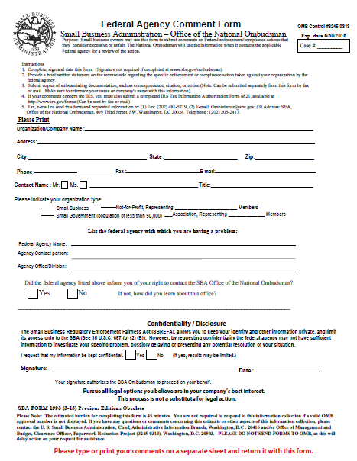
Federal Agency Comment Form
To open a case, simply complete and submit this 1-page authorization at sba.gov/ombudsman/comments

Slide 9
Accountability: Annual Agency Ratings
The Office of the National Ombudsman:
  Scores all Federal agencies that regulate small business on the promptness and substance of responses to small business concerns
  Reports its findings to Congress every year in an Annual Report

Slide 10
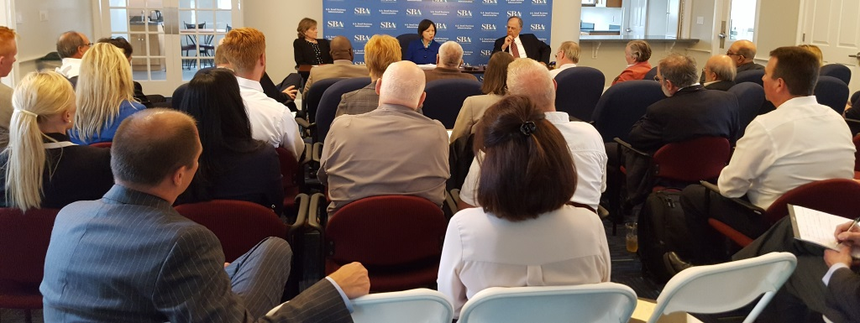
Outreach: Roundtables & Hearings
Forums to voice concerns about unfair enforcement actions & excessive regulations:
Held in all of SBA’s 10 Regions
Board members participate and local Federal agencies’ representatives answer questions
Concerns raised escalated to the appropriate Federal agency for high-level fairness review
Region I Regulatory Enforcement Fairness Roundtable, Nashua NH

Slide 11
Expertise and Regional Conduits: Regulatory Fairness Boards
5-Member Regulatory Fairness Boards comprised of small business owners in each of SBA’s 10 Regions
Vital conduit between small businesses and Federal government. Board members identify and elevate issues to the National Ombudsman
Industries Represented: Agriculture, Contracting Construction, Retail, Professional Services, Health Care, Information Systems, Finance, Transportation
Average experience of Board members: 34 years

Slide 12
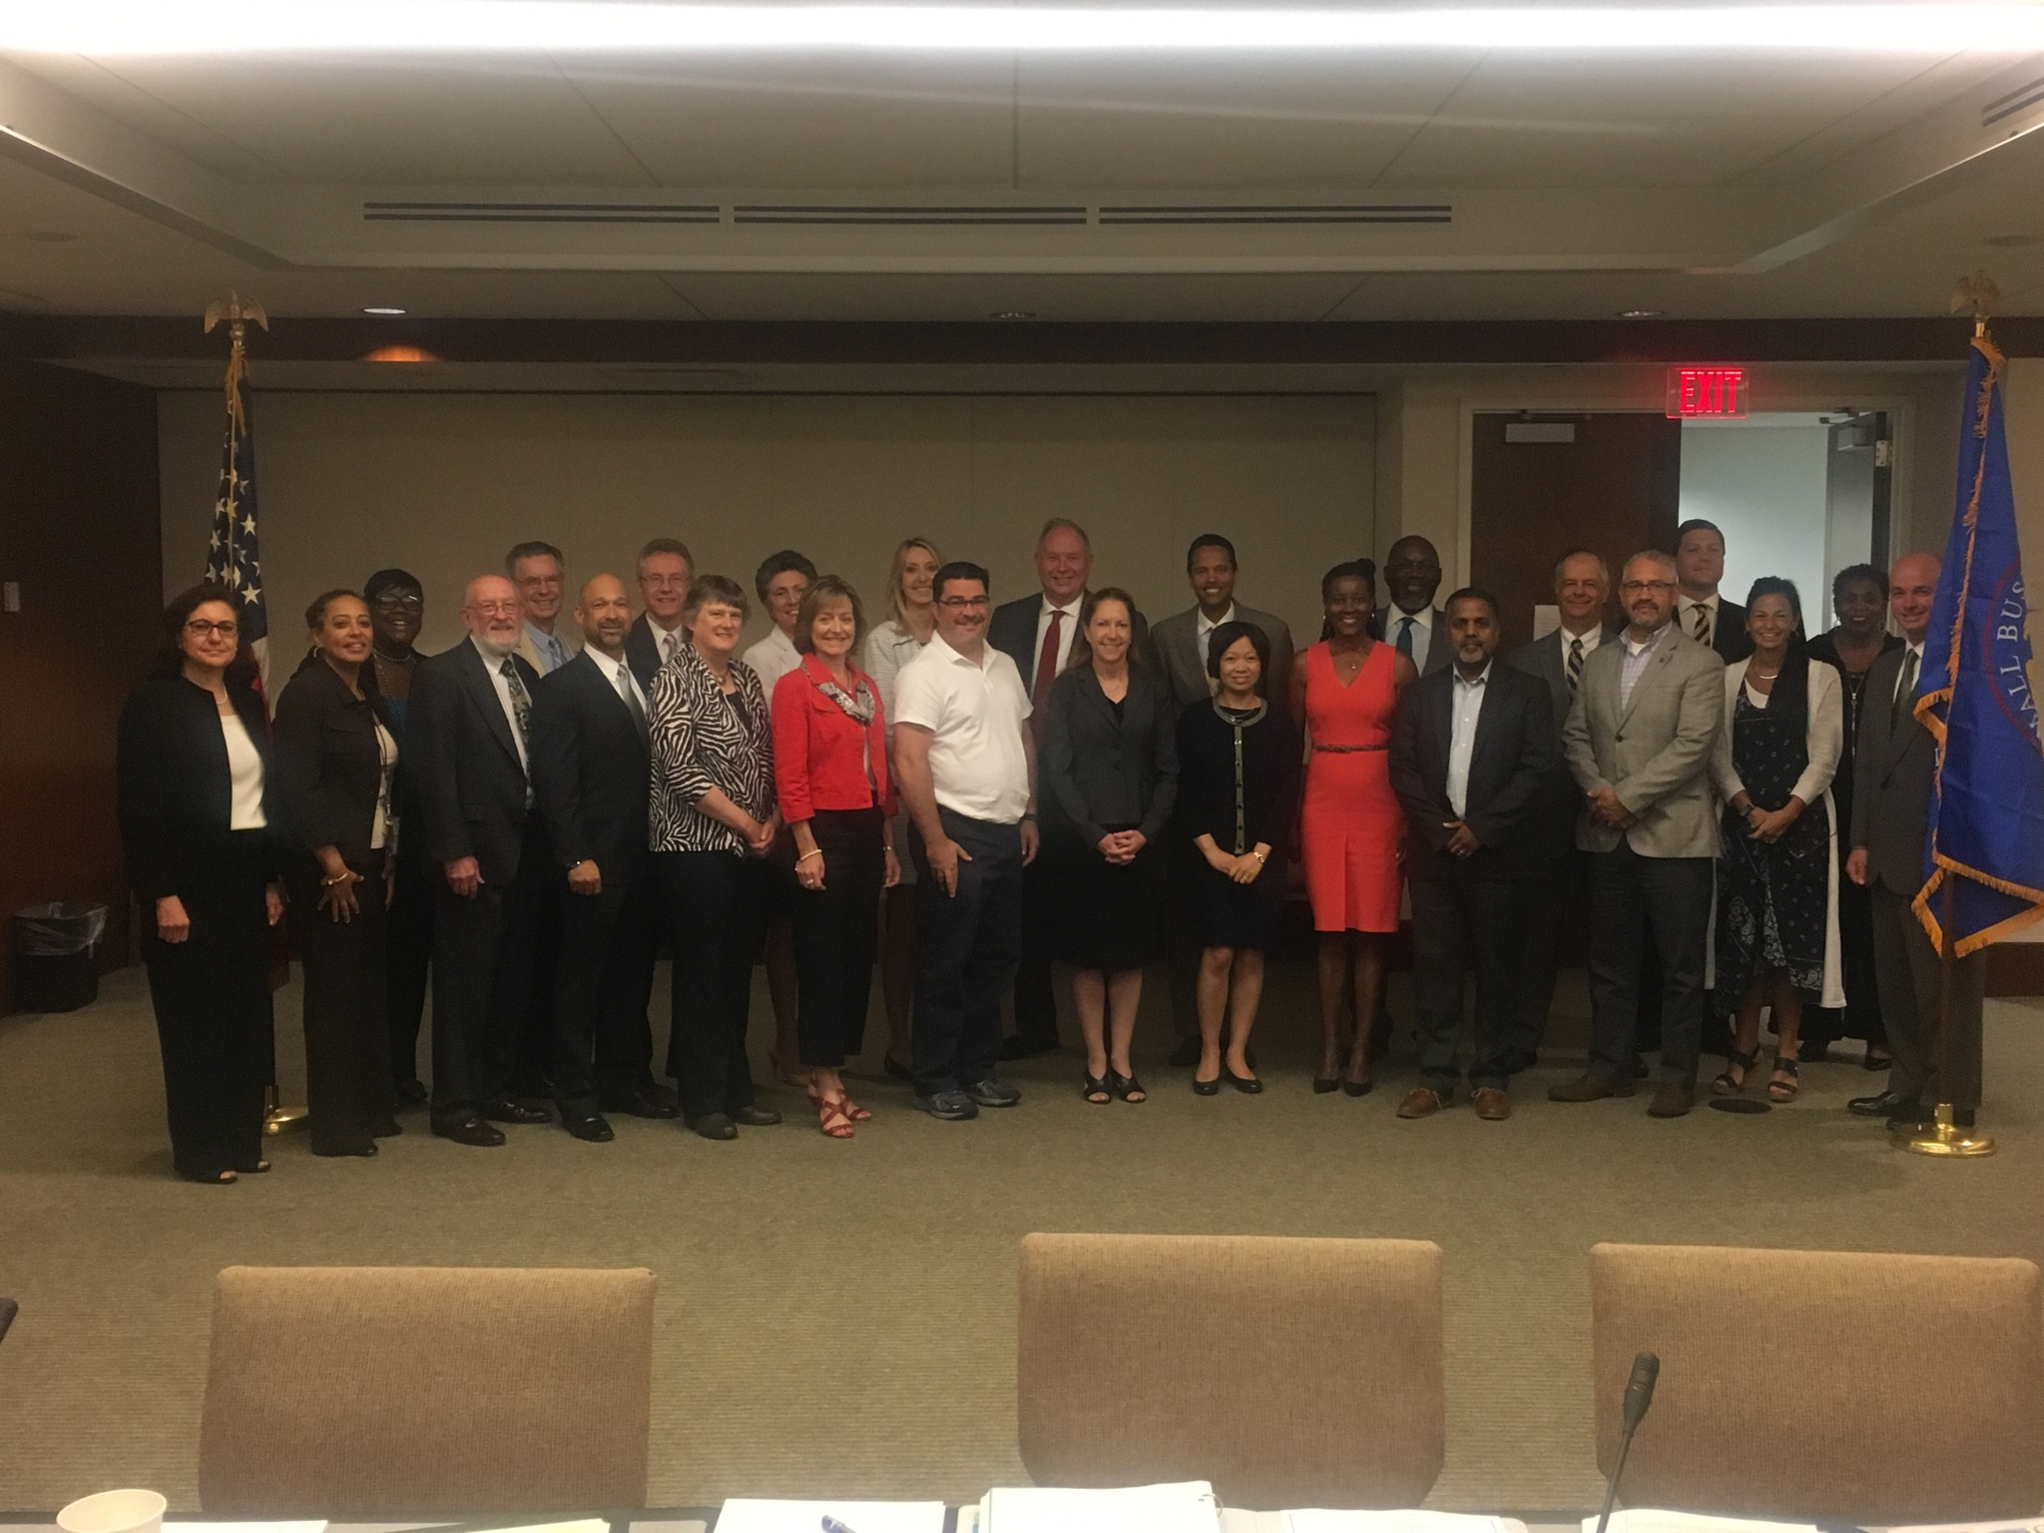
2017 Annual Meeting of the Regional Regulatory Fairness Boards, Washington DC

Slide 13
How To Request
National Ombudsman Assistance
Refer small businesses to the National Ombudsman for issues such as:
- Repetitive audits or investigations by a Federal agency
- Fines or penalties assessed by a Federal agency that do not match the offense committed
- Confusing or unclear paperwork
- Non-responsive Federal employees
- Threats, retaliation, or unprofessional behavior by Federal employees
Contact the Ombudsman directly to report systemic regulatory fairness issues

Slide 14
Federal Agencies Working in Support of Small Business Regulatory Fairness
The Federal agency representatives frequently participate in SBA roundtables in local small business communities
Attend regulatory fairness hearings in person or by telephone
Attend the annual SBA Federal Agency Summit
Agencies provide fact sheets and publications, brochures, and compliance guidance on their websites, at outreach events, and to small employers who are the subject of a complaint issued by a Federal agency

Slide 15
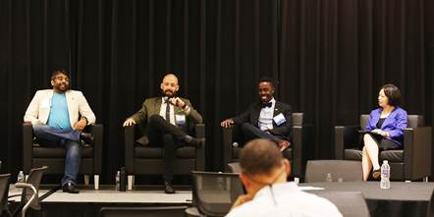
Federal Agencies Working in Support of Small Business Regulatory Fairness
Agency make compliance assistance employees (small business liaisons) available in field offices and by telephone
Publishes a list of small business liaisons on their websites
Provides no cost individualized and specialized compliance assistance
Partners with the SBA, chambers of commerce, and other organizations to conduct educational events
Invention-Con 2017,
U.S. Patent & Trademark Office, Alexandria VA

Slide 16
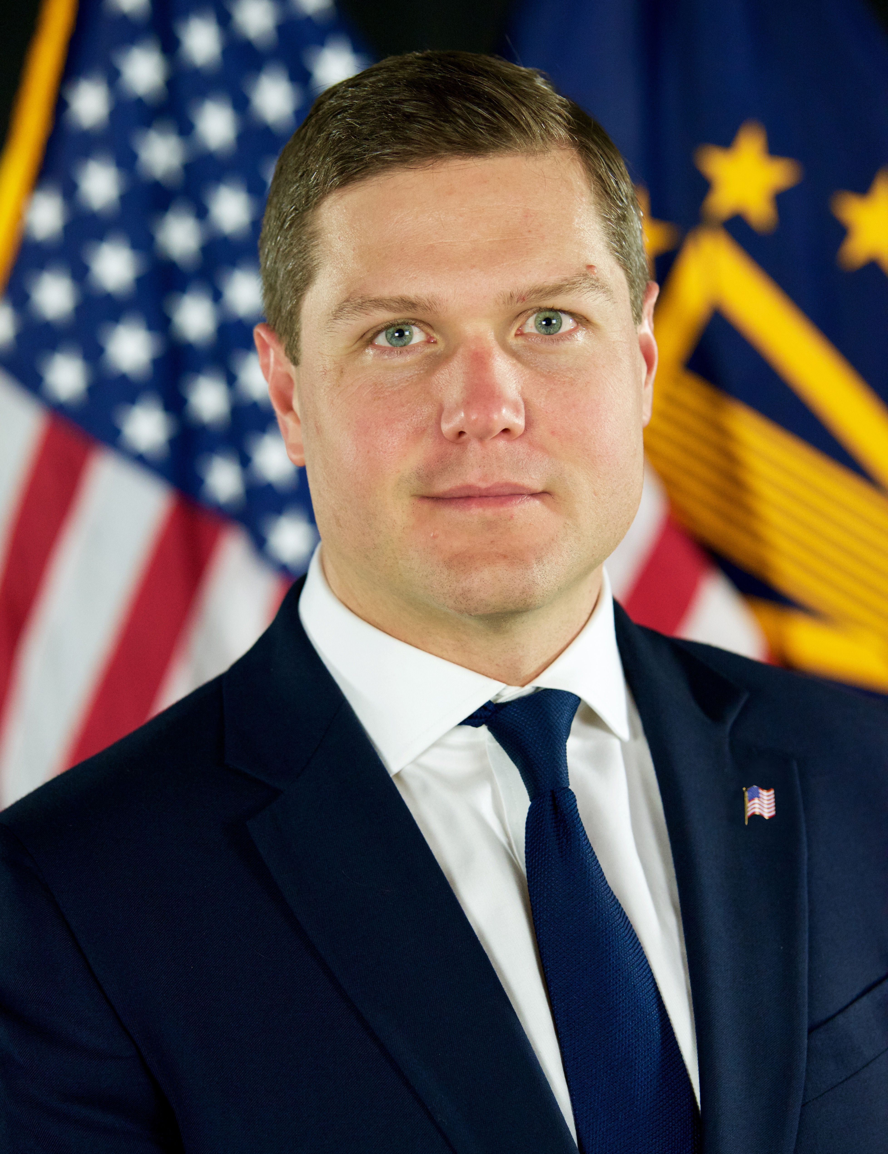
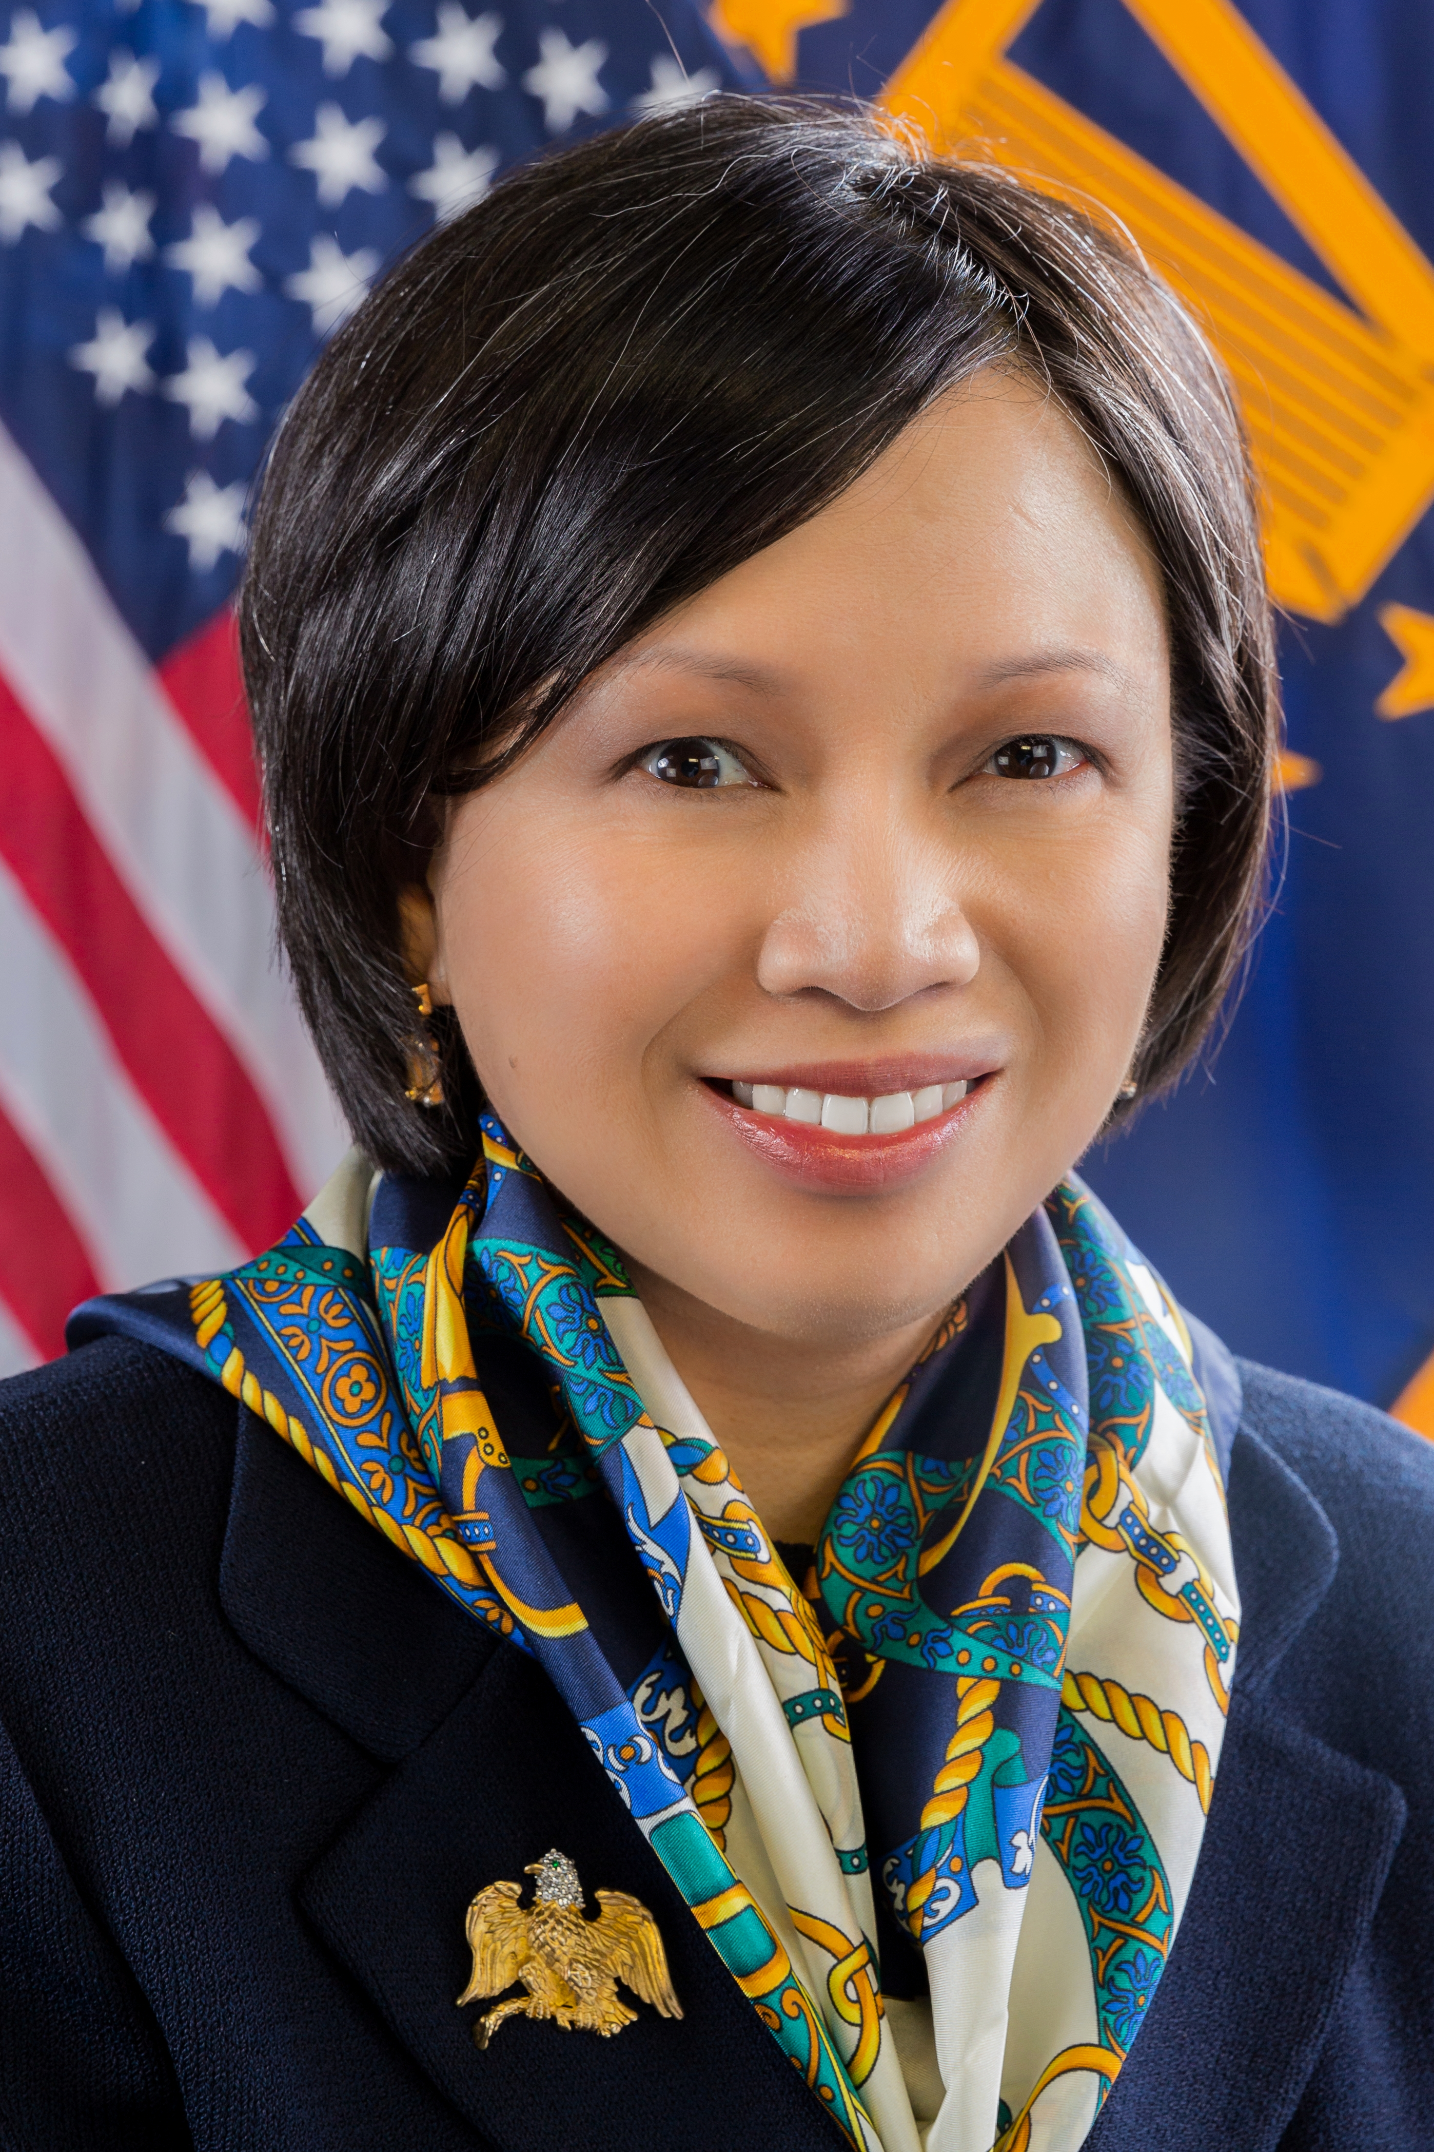
Contact the National Ombudsman
www.sba.gov/ombudsman
ombudsman@sba.gov
888-REG-FAIR
Nathan J. Miller C. Natalie Lui Duncan
National Ombudsman/ Deputy National Ombudsman
Assistant Administrator for natalie.duncan@sba.gov
Regulatory Enforcement Fairness
nathan.miller@sba.gov

