Slide 1
UL & NEC® Requirements for Corrosion Protection of RMC, IMC, and EMT
Notes:
U.S. manufacturers of steel conduit are members of the National Electrical Manufacturers Association (NEMA) Section 5RN and also of the Conduit Committee of the Steel Tube Institute of North America (STINA). The steel conduit products they produce include rigid steel conduit, intermediate metal conduit (IMC) and electrical metallic tubing (EMT).
When selecting a wiring method, life expectancy is one of the key issues typically considered. Depending upon the installation, part of that consideration concerns the resistance of the product to corrosive environments. Today we are going to talk about steel conduit and electrical metallic tubing and corrosion protection issues associated with those products. The information in this presentation will help you to understand corrosion better and evaluate corrosion protection systems.

Slide 2
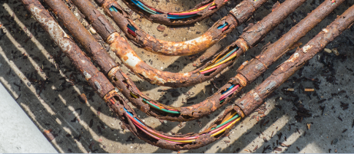
What is Corrosion
The deterioration of a substance, usually a metal, or its properties, because of an undesirable reaction with its environment.
A natural and inevitable but controllable process.
Notes:
When exposed to the atmosphere, all metals have the natural tendency to revert to the lesser energy state of ore. In simple terms, this natural phenomenon is corrosion, and is most commonly seen as iron ore or rust. Steel is an excellent building material – it is readily available, fully recyclable and has a high strength-to-weight ratio, low environmental impact, and long-term durability. However, it is inevitable steel corrodes.
Though corrosion may be more visible, all building materials (concrete, plastic, wood, etc.) diminish and decay over time. Steel is just more honest and transparent – alerting you to any problem areas rather than hiding them until it is too late.
Although we usually think of corrosion in terms of deterioration of metals, all materials can corrode or deteriorate. Though steel corrosion, whether in atmospheric, soil, water, or other exposures, is a natural phenomenon, it can be stymied if proper corrosion protection methods are employed.

Slide 3
Frequently Asked Questions
“How long will my conduit, nipples and elbows last?”
“Do I need to use supplementary corrosion protections?”
“What happens if I use this outdoors, underground or in concrete?”
“Can I use steel conduit with aluminum fittings?”
“How can I reduce the chance of corrosion?”
“What material should I use in this environment?”
Notes:
Steel conduit systems provide long-lasting protection to the conductors and cables within. Some of the most frequent questions about steel conduit deal with concerns about corrosion and the life expectancy. Due to the changing environments in which conduit is installed, it is impossible to provide firm life expectancy data. However, an understanding of the corrosion protection requirements of steel conduit product standards and of the National Electrical Code® (NEC) together with guidelines on the use of supplementary corrosion protection will help in the selection of the best system for the installed environment.

Slide 4
Why Use Zinc as Primary Coating?
Protects steel from rusting in 2 ways:
  Barrier protection
    Protective layer between steel and environment (similar to paint)
  Galvanic protection
    Zinc coating is sacrificed to prevent corrosion of steel
    Zinc corrodes thus protecting the underlying steel
Notes:
Zinc, like all metals, is a natural component of the Earth’s crust and an inherent part of our environment. It makes up an estimated 0.004% of the Earth’s crust, and ranks 27th in order of abundance. The process of applying zinc over steel is called “galvanizing” and has been used to protect iron and steel from rusting for over two hundred years. Zinc has a number of characteristics that make it well-suited to provide corrosion protection to steel products. It protects steel from rusting by forming a protective barrier between the steel and the environment. In addition, it provides sacrificial (galvanic) protection. These levels of corrosion protection provide galvanized steel with maintenance-free longevity for decades. And galvanizing can contribute positively to sustainable development initiatives because of its maintenance-free longevity, 100% recyclability, minimal environmental impact, and economic savings for future generations. However once the zinc has diminished, the steel is now unprotected.

Slide 5
Why Zinc?
When iron corrodes the byproduct is Red
When zinc corrodes the byproduct is White
Notes:
When steel or iron rusts, the oxide is red. The appearance of white powder on steel conduit or EMT is evidence that the zinc coating is doing its job; when zinc corrodes, the oxide is white.

Slide 6
UL Standards
Manufacturers can use any of the primary protective coatings and whatever process they choose (hot-dip galvanizing, in-line galvanizing, electroplating, etc.) as long as their products pass the performance requirements.

Slide 7
UL Standards
Performance requirements for zinc coatings
  “A protective coating of zinc shall cover completely, shall adhere firmly at all points, shall be smooth and free from blisters and other defects that can lessen the protective value of the coating, shall be in metal-to-metal contact with the steel and shall comply with Clause 6.2.2.”
Surface Treatments
  It is allowed to have a thin top coat or conversion coating for extra protection
Notes:
The UL standards for RMC, IMC and EMT include performance requirements for the coatings. (Read slide).
A Conversion Coating is a protective surface layer on a metal that is created by a chemical reaction between the metal and a chemical solution. It changes the surface chemistry by forming compounds that remain on the surface.
The UL standards allow the use of a surface coating on top of the primary corrosion protection coating (e.g. zinc) and most U.S. manufacturers do use a surface coating to provide additional corrosion protection.
An organic coating is a film that is applied to a surface to enhance some property of that surface. In this particular case it is for improving the corrosion resistance. The organic coating does not react with the surface to change anything – it stays on top of the surface and forms a protective barrier that keeps the surface from being in contact with the surrounding environment. Organic simply refers to the composition of the coating being a carbon-based chemical compound such as paint, wax, polymer, etc.)

Slide 8
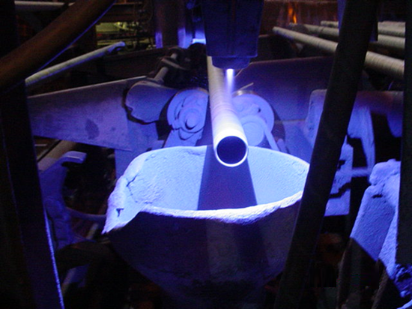
UL Standards
Threads For Rigid and IMC
  Have a protective coating applied at the Factory
  Threads are protected by one of three processes:
    Zinc Spray Metallizing
    Electroplating
    Zinc-rich Paints

Slide 9
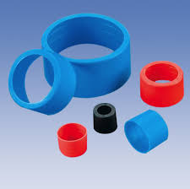
UL Standards
Thread Protectors For RMC and IMC
  Are shipped with a thread protector on one end and a coupling on the other end
    (Manufacturers typically color-code thread protectors to aid trade size identification)
Notes:
For rigid, even trade sizes are color-coded blue, ½ trade sizes are black and ¾ trade sizes are red. For IMC, even trade sizes are orange, ½ are yellow and ¾ are green.

Slide 10
UL Guidelines Corrosion Protection Summary
In Concrete | Required | Optional
Rigid Steel |  | X
Intermediate Steel |  | X
Aluminum Rigid | X
Steel EMT | May be needed below grade | Optional on or above grade
Aluminum EMT | X
In Soil
Rigid Steel |  | X
Intermediate Steel |  | X
Aluminum Rigid | X
Steel EMT | Generally Required
Aluminum EMT | X
From: Soares Book on Grounding
Notes:
This chart from the Soares Book on Grounding provides a summary of the corrosion protection requirements found in the UL White Book and the UL Green Book. Note that if aluminum is used in concrete or is direct-buried, it must have supplementary corrosion protection.

Slide 11
NEC Requirements - Article 344
Rigid Metal Conduit
Steel and Stainless Steel
  All atmospheric conditions and occupancies
  In concrete, direct burial and “areas subject to severe corrosive influences where protected by corrosion protection and judged suitable for the condition”
Red Brass (only available in trade size ½)
  Direct Burial
  Swimming Pools
  In concrete, direct burial and “areas subject to severe corrosive influences where protected by corrosion protection and judged suitable for the condition:”
Aluminum
  “Where judged suitable for the environment”
  “In concrete, direct buried where provided with approved supplementary corrosion protection”
Notes:
Article 344. Note that Article 344 is entitled Rigid Metal Conduit. This article covers not only rigid steel conduit, but rigid aluminum, red brass and stainless steel conduit. In the 2011 NEC, language in Article 344 was clarified to show the differences in corrosion protection requirements for the different metals

Slide 12
What’s the Difference?
“where protected by corrosion protection”
  UL Listed steel conduit meets this requirement- it IS “protected by corrosion protection”.
“where provided with approved supplementary corrosion protection”
  Supplementary corrosion protection must be added*
    Paint
    Tape
    Factory–applied PVC coating
Notes:
READ SLIDE

Slide 13
NEC Requirements - Article 342 Intermediate Metal Conduit
IMC is only available in steel
Requirements are the same as rigid steel conduit
NEC Requirements - Article 358 Electrical Metallic Tubing
In concrete, in soil or in areas subject to severe corrosive influences where protected by corrosion protection and judged suitable for the condition.
    Note: UL listed EMT meets this requirement. It IS protected by corrosion protection.

Slide 14
NEC Requirements 300.6
Protection Against Corrosion and Deterioration
  Ferrous Metal Equipment
  Aluminum Equipment
  Nonmetallic Equipment
Field-cut Threads
  “Where corrosion protection is necessary”
  Threads must be coated with an “approved electrically conductive, corrosion-resistant compound”
    Zinc-rich paints or similar compound
    Listed product available
Indoor Wet Location
  ¼” stand-off required between wall and conduit/tubing
Notes:
Article 300. Article 300 covers general requirements for wiring methods. Section 300.6 is entitled Protection Against Corrosion and Deterioration and contains requirements for ferrous metal equipment, aluminum equipment and nonmetallic equipment. This section includes many of the same requirements that are found in the individual conduit and EMT Articles.
It also includes a rule for field-cut threads. As noted above, the threads on conduit shipped from the factory are required to be coated by the UL standards. The NEC makes sure that “where corrosion protection is necessary”, field-cut threads are coated with an approved electrically conductive, corrosion-resistant compound. This means that the coating used must have the approval of the AHJ. Zinc-rich paints or similar compounds are commonly used and there is a compound with a UL listing available.

Slide 15
Supplementary Corrosion Protection
Paints*
  Zinc-rich paints
  Acrylic, urethane or weather stable epoxy-based resins
  Oil-based or alkyd paints are unacceptable
Bitumastic Coating
Tape wraps*
  With special high tack adhesives
  Must overlap and cover the entire surface of the conduit and fittings
  May require application of a primer
Shrink wrapping (couplings and fittings)*
Factory –applied coating (PVC coated conduit)- additional to the primary corrosion protection coating on the conduit/tubing – contact factory for information
*Subject top the approval of Authority Having Jurisdiction
Notes:
While the coatings on steel conduit and EMT provide excellent corrosion protection, supplementary corrosion protection may be necessary in very corrosive environments.
Types of supplementary corrosion protection include paints, tape wraps, or shrink wraps which are subject to the approval of the Authority Having Jurisdiction.
Steel conduit with factory-applied PVC coating, which is additional to the primary coating, is also available. Supplementary corrosion protection of this type is not covered in this module. The manufacturers of PVC coated conduit have processes and methods unique to their companies. They also have extensive training materials and programs. Where it is determined that the factory-produced product is necessary for the application, please contact the manufacturer and they will provide any assistance needed in evaluating the protection and installation requirements.
Paints. A bitumastic coating, zinc-rich paints or acrylic, urethane or weather stable epoxy-based resins are frequently used. Oil-based or alkyd paints should not be used.
Tapes and Wraps. Several companies sell PVC-based tapes with special high tack adhesives to provide supplementary corrosion protection. These tapes must overlap and cover the entire surface of the conduit and fittings. Manufacturers of these types of tapes will provide installation recommendations.

Slide 16
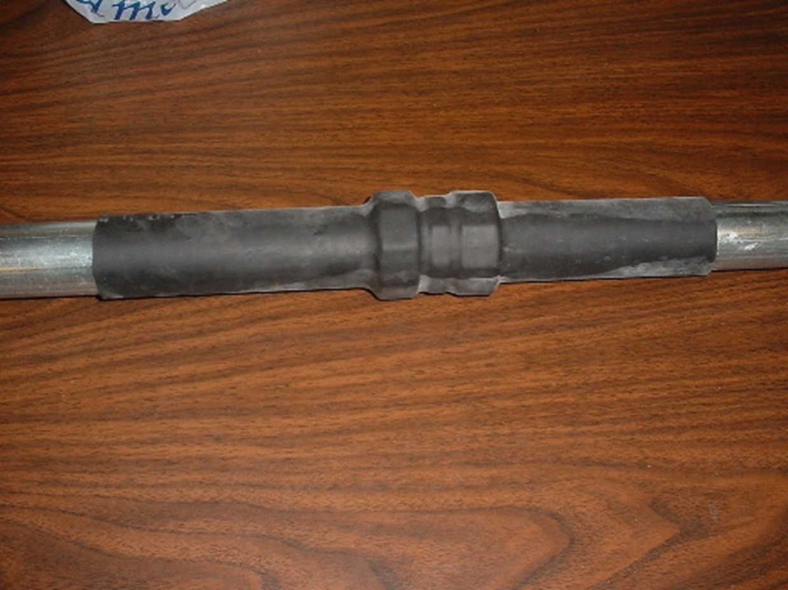
Shrink Wrapping System
Notes:
Here is a photo of a shrink wrapping system that does not require a heat source.

Slide 17
Supplementary Corrosion Protection PVC Coated Conduit
UL Standards
  Supplementary Coatings (Factory)
    It is permitted to have a coating on the outside of the conduit, in addition to the primary coating, for protection against severe corrosive conditions.

Slide 18


Supplementary Corrosion Protection PVC Coated Conduit
UL Standards
  Performance tests for PVC adhesion
    The PVC must break before removal from the substrate after making two parallel cuts and one perpendicular cut on the coating.

Slide 19
Protecting Steel
Protecting with Zinc
  Barrier protection
    isolates the metal from the electrolytes
    three alloy layers and a layer of pure metallic zinc
  Cathodic protection
    introduces a new corrosion element
Notes:
Barrier protection is perhaps the oldest and most widely used method of corrosion protection. The “barrier” isolates the metal from the electrolytes in the environment. Two important properties of barrier protection are adhesion to the base metal and abrasion resistance. The coating microstructure consisting of three alloy layers and a layer of pure metallic zinc. The Gamma, Delta, and Zeta layers are harder than the underlying steel. The hardness of these inner layers provides exceptional protection against coating damage through abrasion. The Eta layer of the galvanized coating is quite ductile and provides some resistance to impact.
Cathodic protection requires changing an element of the corrosion circuit, introducing a new corrosion element, and ensuring the base metal becomes the cathodic element of the circuit.
The protected metal becomes the cathode and does not corrode. The anode corrodes, thereby providing the desired sacrificial protection. In nearly all electrolytes encountered in everyday use, zinc is anodic to steel. Thus, the galvanized coating provides cathodic corrosion protection as well as barrier protection.
Coatings, paint without zinc-dust, tapes and wraps provide barrier protection only.

Slide 20
ASTM A 780-01
Covers use of low melting point zinc alloy repair rods or powers, the use of paints containing zinc dust, and use of zinc spray.
Touch-up and repair of galvanized steel can be completed in several different ways, including the use of zinc solders, zinc-rich paints, and/or zinc spray metallizing.
Notes:
ASTM A 780, Standard Practice for Repair of Damaged and Uncoated Areas of Hot-Dip Galvanized Coatings, covers use of low melting point zinc alloy repair rods or powers, the use of paints containing zinc dust, and use of zinc spray.
Touch-up and repair of galvanized steel, to meet ASTM A780, can be completed in several different ways, including use of zinc-rich paint, zinc solders and/or zinc spray metallizing.

Slide 21

Three Material Types
Zinc-Based Solders
  Application temperature 446°F – 570°F
  Rod form or powder
Paints containing zinc dust
  Zinc dust contractions range of 65 – 69% or above 92% in dry film
  Pre-mixed
  Sprayed Zinc (Metallizing)
  Requires blast cleaning the surface to be reconditioned
  Applied with metal-spraying pistols using zinc wire or zinc powder

Slide 22
Recommended for Touch-up
Paints containing zinc dust
  Zinc-rich paints contain 65 – 95% metallic zinc in dry film, with 92 being common
  Provides both galvanic and barrier protection when properly applied
  Paints can be brushed or sprayed on to the steel
Notes:
Zinc-rich paint is applied to a clean, dry steel surface by either a brush or spray. Zinc-rich paints contain 65-95% metallic zinc in dry film, with 92-95% being common. Paints containing zinc dust are classified as organic or inorganic, depending on the binder they contain. Inorganic zinc-rich paints adhere to the steel with mild chemical reactivity, have good solvent resistance and can withstand temperature up to about 700 F. Inorganic zinc-rich paints do not chalk, peel, or blister readily, are easy to weld and provide simpler cleanup than organics and are particularly suitable for touch-up applications of undamaged hot-dip galvanized areas. The coating thickness for the paint must be 50% more than the surrounding coating thickness, but not greater than 4.0 mils (100 μm), and measurements should be taken with either a magnetic, electromagnetic, or eddy current gauge to ensure compliance.
The galvanized coating on steel raceways can be compromised during delivery, handling, installation, and while in use. Some cathodic protection is offered to bare areas of the steel by the surrounding galvanized coating, but these areas can still rust if the area is too wide or corrosive elements are present. Research has shown the galvanized coating offers cathodic protection to bare areas between 1 mm - 5 mm wide depending on the electrolyte that electrically connects the galvanized coating to the bare area. Bare areas should be touched-up in accordance with the procedures outlined in the repair standard to ensure longevity of the surrounding coating.

Slide 23
Corrosion Prevention Methods
Materials Selection
Cathodic Protection
Alteration of Environment
Design Issues
Coatings
Notes:
Corrosion is a very complex subject. The performance of a material in different environments is governed by a number of factors, including the potential and resistance between anodic and cathodic areas, dust, harsh chemicals, the pH of the environment, temperature and humidity. Appropriate product selection, good maintenance procedures, and/or control of environmental factors can slow the rate of corrosion

Slide 24
Corrosive Environmental Conditions
Dust
Harsh chemicals
Temperature
Moisture
pH
Notes:
We have discussed the use of galvanized steel conduit and EMT in corrosive environments such as concrete and soil. Dust can also be very corrosive to certain materials. Harsh chemicals can affect both metal and nonmetallic conduits. Manufacturers of these products can be contacted for information on the reaction of their products in certain chemical environments. Due to the endless variety of conditions and possible methods of use, however, the best determination of suitability for use remains local experience.
Temperature and moisture are two other important considerations.
Corrosion in liquid chemical environments is affected by the pH of the solution.

Slide 25
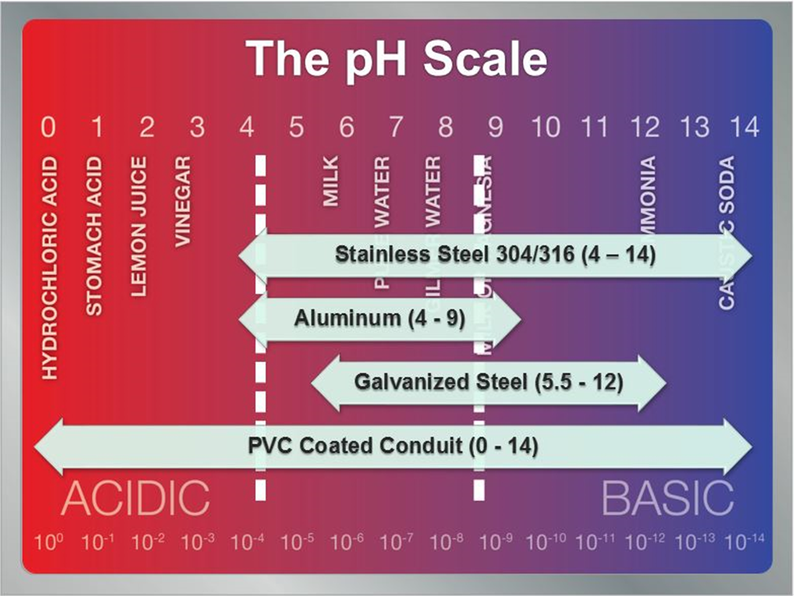
The pH Scale
Galvanized Steel 5.5 – 12 = good pH range
Aluminum 4 – 9 = good pH range
Notes:
According to the American Galvanizers Association, galvanizing performs well in solutions of pH above 4.0 and below 12.5. Aluminum performs well in a range of 4-9.

Slide 26
In Conclusion
Coatings on Steel Conduit and EMT provide excellent corrosion protection and contribute to long service life. For severely corrosive areas, additional protection can be applied to further extend the life expectancy of the installation.

