Slide 1
The Evaluation of Steel Conduit and EMT as Equipment Grounding Conductors

Slide 2
Safety First
Grounding & Bonding is paramount to a safe installation and offers protection against:
Lightening & Voltage Surges
Short Circuits
Ground Faults
Limit Fire & Shock Hazards
Verification of an adequate and safe effective fault return path is a requirement.
All metal parts that may become a part of this path must be bonded (connected) together.
Notes:
Emphasize the points listed.
*Helpful references: 110.10 250.4, and Table 250.122
Article 250 Part VI. Equipment Grounding and Equipment Grounding Conductors
250.134A
*Info based on the 2017 NEC.

Slide 3
NEC 110.10
“The overcurrent protective devices, the total impedance, the equipment short-circuit current ratings, and other characteristics of the circuit to be protected shall be selected and coordinated to permit the circuit protective devices used to clear a fault to do so without extensive damage to the electrical equipment of the circuit.”
“This fault shall be assumed to be either between two or more of the circuit conductors or between any circuit conductor and the equipment grounding conductor(s) permitted in 250.118. Listed equipment applied in accordance with their listing shall be considered to meet the requirements of this section.”

Slide 4
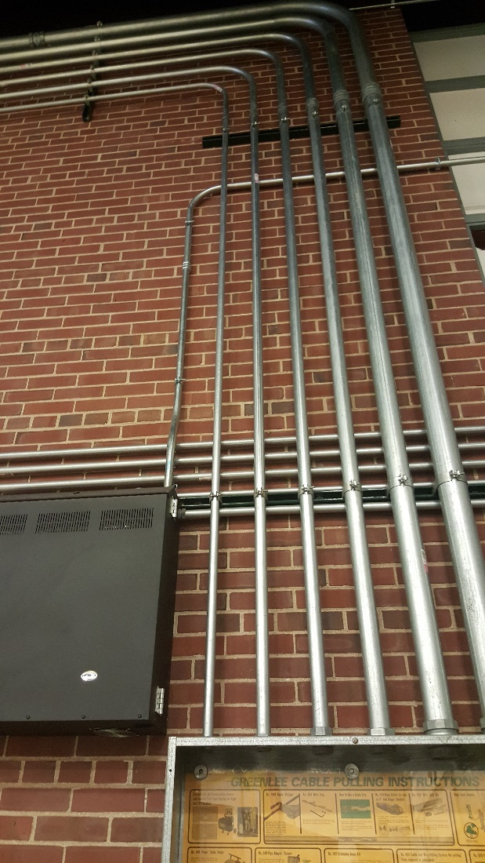
NEC 300.10 and 300.12
Metal raceways, cable armor, and other metal enclosures for conductors shall be mechanically joined together into a continuous electrical conductor and shall be connected to all boxes, fittings, and cabinets so as to provide effective electrical continuity.
Mechanical Continuity — Raceways and Cables
Metallic or nonmetallic raceways, cable armors, and cable sheaths shall be continuous between cabinets, boxes, fittings, or other enclosures or outlets.
Notes:
Unless specifically permitted elsewhere in this Code, raceways and cable assemblies shall be mechanically secured to boxes, fittings, cabinets, and other enclosures to provide electrical continuity.
All connections must be tight. Where threadless couplings are employed the tubing must be fully inserted and properly tightened.

Slide 5
NEC 250.118 “Types of Equipment Grounding Conductors”
Conduit and Tubing approved as an EGC:
A copper, aluminum or copper-clad aluminum conductor
Rigid metal conduit
Electrical metallic tubing
Intermediate metal conduit
Notes:
In addition to the four mentioned today there are 10 other wiring methods mentioned under Article 250.118 of the NEC. Please refer to 250.118 for a complete lists of wiring methods.
*** There is animation added to the list clicking the mouse will make one of the four bullet points appear on the slide.***

Slide 6
NEC 250.4(A)(5)
“Effective Ground-Fault Current Path. Electrical equipment and wiring and other electrically conductive material likely to become energized shall be installed in a manner that creates a low-impedance circuit facilitating the operation of the overcurrent device or ground detector for high-impedance grounded systems.
It shall be capable of safely carrying the maximum ground-fault current likely to be imposed on it from any point on the wiring system where a ground fault may occur to the electrical supply source.”
“Bonding of Electrical Equipment. “Non-current-carrying conductive materials enclosing electrical conductors or equipment, or forming part of such equipment shall be connected together and to the supply system grounded equipment in a manner that creates a low-impedance path for ground-fault current that is capable of carrying the maximum fault current likely to be imposed on it.”

Slide 7
Paths to Ground
Grounded (Neutral)
Metallic Raceway (EGC)
Equipment Grounding Conductor (EGC)
Grounding Electrode Conductor (GEC)
Grounding Electrodes
Notes:
An all inclusive list of EGCs is contained in 250.118. However, during a ground fault there are usually multiple paths. We want to insure a low impedance path to comply with the NEC requirements.

Slide 8
NEC 250.24(A)(5)
“Load-Side Grounding Connections. A grounded conductor shall not be connected to normally non-current-carrying metal parts of equipment, to equipment grounding conductor(s), or be reconnected to ground on the load side of the service disconnecting means except as otherwise permitted in this article.”
Notes:
Single point bonding of the Neutral (grounded) conductor and the EGC (equipment grounding conductor) is now required in all except existing installations.

Slide 9
NEC 250.122
Size of Equipment Grounding Conductors
“(A) General. Copper, aluminum, or copper-clad aluminum equipment grounding conductors of the wire type shall not be smaller than shown in Table 250.122…
Where a cable tray, a raceway, or a cable armor or sheath is used as the equipment grounding conductor, as provided in 250.118 and 250.134(A), it shall comply with 250.4(A)(5) or (B)(4).”
Notes:
“(A) General. Copper, aluminum, or copper-clad aluminum equipment grounding conductors of the wire type shall not be smaller than shown in Table 250.122, but in no case shall they be required to be larger than the circuit conductors supplying the equipment.
Where a cable tray, a raceway, or a cable armor or sheath is used as the equipment grounding conductor, as provided in 250.118 and 250.134(A), it shall comply with 250.4(A)(5) or (B)(4).”

Slide 10
Note: Where necessary to comply with 250.4(A)(5) or (B)(4), the equipment grounding conductor shall be sized larger than given in this table .
*See installation restrictions in 250.120
Notes:
Emphasize in the title Minimum Size and the Note under the table is code enforceable, unlike informational notes which are not enforceable
With the GEMI software this is easy to confirm.

Slide 11
Bonding conductor

Slide 12
GEMI Background
GEMI: Grounding and Electro-Magnetic Interference Analysis Software
1992 Grounding Study Initiated at Georgia Institute of Technology
1994 Phase I completed (Grounding Study) “Modeling and Testing of Steel EMT, IMC, and Rigid Conduit”
1997 Phase II Completed “ Modeling and Evaluation of Conduit Systems for Harmonics and Electromagnetic Fields”
1999 GEMI Software-Windows version
2002-04 GEMI updates

Slide 13
GEMI: Phase One Performance of Grounding Paths
Are steel RMC, IMC, and EMT effective equipment grounding conductors?
What length run can be safely installed?
Does supplementary EGC lengthen the run?

Slide 14
About the Project
In-Laboratory Resistance & Permeability Tests
Computer Modeling
Full Scale Field Testing
Written Report
User Software Released
IEEE Paper
Notes:
Georgia Institute of Technology ( GA Tech) was awarded the project. Doctor A. P. “Sakis” Meliopoulos, Professor and head of the Electrical Engineering Department at GA Tech headed the project. Dr. A. P. “Sakis” Meliopoulos, Georgia Power Distinguished Professor of electrical and computer engineering at Georgia Tech, has led the development of several software and hardware products used by the industry. His expertise is in the areas of fault analysis and simulation of power systems, advanced instrumentation for monitoring and protecting power systems, and electromagnetic transients, harmonics, grounding, and surge protection. The principal developer of the EPRI program SGW (SOMIP, SMECC, SGSYS, TGRND), program DGAP, and WinIGS, he is the leader in the development of the Harmonic Measurement System, which is based on synchronized measurements. He is principal inventor of the Smart Ground Multimeter, the Fault Distance Indicator, and the Open Conductor Detector. He is the author of Power System Grounding and Transients, Marcel Dekker Inc., 1988; Section 27, “Lightning and Overvoltage Protection,” of the Standard Handbook for Electrical Engineers, McGraw Hill, 1993. He holds three patents and has published more than 220 technical papers. Meliopoulos is the chairman of the Georgia Tech Protective Relaying Conference, a Fellow of the IEEE, and the recipient of the 2005 Richard Harold Kaufman Award.
GA-TECH obtained samples of various steel raceways from local suppliers and conducted their own resistance and permeability testing.
Based on this information they developed a computer model.
Field testing was performed to validate the accuracy of the computer model .
They prepared a written report. Note: In addition to the software this report can be downloaded free at www.steelconduit.org.
GA Tech then developed a computer software program. The original software was not user friendly and was later converted to a windows version. Once Phase II was added the title (GEMI) was used.
A paper was prepared and presented by GA Tech for IEEE. It is available from IEEE.

Slide 15
Illustration of Kearney Laboratories facility
Notes:
This is the field test site at McCook IL Kearney Laboratories. GA-Tech selected this laboratory because it was one of the few labs with the necessary large transformer to supply the test.
There were nine runs of ½ through 3 EMT, IMC and rigid. Each run was 256 feet long. The reason for 256 feet was simply that was all the available space.
In each run there were 25 standard lengths. Joining was with threaded steel couplings for the rigid and IMC. For EMT steel and die-cast, both compression and set screw type, couplings were used. The written report gives the exact data and on each.
A 3- foot piece supported on a wooden test block was installed for attaching the test leads. We will see this set-up later in the presentation.

Slide 16
Kearney Laboratory Transformer and Control Room in Mccook, IL

Slide 17
Kearney Lab Testing Facility
Notes:
All tests were validated and recorded by both Kearney Laboratories and Professor “Sakis” Meliopoulos. Each had their own instruments attached and made their own readings and then compared them for accuracy.

Slide 18
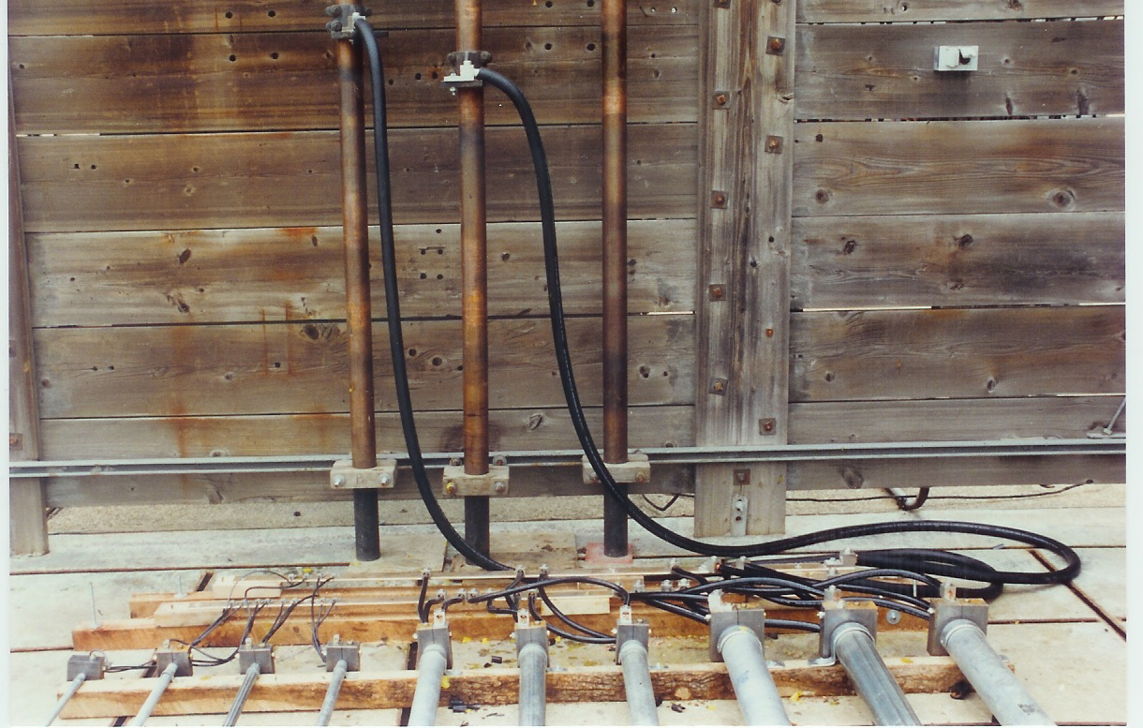
Test Blocks and Leads to Transformer

Slide 19
Full Scale Test Set-Up
Illustration of the layout of ten runs of Steel Conduit. Power conductors were enclosed but not shown. Total length of each conduit run is 256 feet. Wood blocks were used to space the steel.
Notes:
The installation was made by a licensed electrical contractor to comply with the NEC installation requirements.
All conduit, EMT and couplings were from local supply house.
Both compression and setscrew couplings were used on the EMT. Standard threaded couplings that came on the RMC and IMC were used.
No sparking or heating was observed or detected.

Slide 20
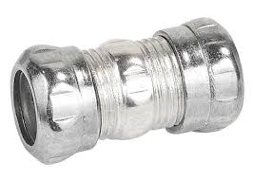
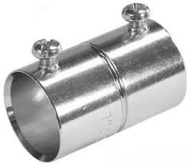
Fittings Used in the Testing
Tests at both 120 & 277 volts to ground were run using zinc die-cast and steel set-screw and compression couplings with no significant difference in the overall impedance.
Notes:
Table 5.4 of the written report compares the impedance under all tested circumstances. This report can be downloaded from www.steelconduit.org

Slide 21
Grounding Concerns
(a) Single Phase Circuit without Ground Conductor
(b) Single Phase Circuit with Ground Conductor
(c) Three Phase Circuit without Neutral
(d) Three Phase Circuit with Neutral
Load
(a)
Load
(b)
Load
(c)
Load
(d)
Notes:
About 90 tests were run and included both single and 3 phase.
We looked at all possible fault conditions that might occur
(a) Single Phase Circuit without Ground Conductor
(b) Single Phase Circuit with Ground Conductor
(c) Three Phase Circuit without Neutral
(d) Three Phase Circuit with Neutral

Slide 22
NEC Validation
Validates 250.118
Safe Lengths for :
Rigid steel conduit
Intermediate metal conduit
Electrical metallic tubing
Validates Table 250.122
Safe Lengths for Copper & Aluminum Conductors

Slide 23
GEMI Opening Screen
Notes:
This is the first thing you see when you open the GEMI program.
Select “Single Circuit Analysis - Steel”.

Slide 24
Maximum System Length 40 Volt Arc-400% of Protective OC Device
The software predicts maximum sage circuits lengths.
RMC, IMC, and EMT
Copper and Aluminum Conductors
Line to ground faults
Line to line or line to neutral faults
Note: All other paths must be considered to establish the limiting condition. Each additional ground return path reduces the overall impedance.
Notes:
GA-Tech recognized that in most installations there will be multiple paths such as earth, building steel, etc. This was taken into account in the development of the software.

Slide 25
Select Parameters
Select type of conduit or tubing
Size
Temperature
Select Copper or Aluminum Conductors
Size
Temperature
Fault Clearing Current
Based on the overcurrent device
Check MFG trip curves (4-5 times the OC Rating)
Circuit voltage to ground
Arc Voltage
40 volts unless you have different information
A bolted fault is unlikely
Notes:
Once all of these selections have been made, click UPDATE.

Slide 26
Click on “Update”
Notes:
Once you click on update the calculation is complete and the maximum circuit length in feet appears. Then you can simply change the type of conduit, UPDATE again, and you will have a new length. By repeating this process you can compare the three types of steel conduit using the exact same parameters.
The program will remember this information and you can add a supplementary conductor and compare or make the calculation without steel conduit. By making this comparison you can then decide what you want to install.
If you need a longer length then you can increase the size of the conductors or conduit.

Slide 27
Arcing Fault Compare Allowable Safe Lengths
Notes:
You can use your mouse pointer to initiate the calculations on the right at any point on the graph.
Maximum length is based on the percent of the overcurrent device used to initiate the trip time.

Slide 28
Fault Currents Are low
Notes:
The concern is will an average arcing fault in a motor or outlet with a fault current that is relatively low trip the OC device before it starts a fire or does other damage. NEC 110.10 states we must design our systems so that it will!

Slide 29
Summary of Key Findings
Steel EMT, IMC, and RMC meet the NEC requirements for EGCs.
Comparably sized steel EMT, IMC, and RMC allow flow of higher fault current than aluminum or copper EGCs.
Steel EMT, IMC, and RMC provide a low impedance path to ground.
Facilitate operation of OC devices in runs not exceeding maximum allowable lengths detailed in the report
Supplementary equipment grounding conductors, when participating in the fault circuit, reduce the overall impedance…
Do not add to safety in phase to neutral fault
May increase allowable length of steel conduit, dependent on size and system design
Steel conduit is not the limiting factor in conductor to neutral fault

