Slide 1
SBA Loan Programs to Support Small Business Exporters

Slide 2
SBA’s Office of International Trade
Federal-State Trade Development & State Trade Expansion Program
International Trade Finance
International Trade Affairs
Matching funding program to States for U.S. small business exporting assistance.
Loans for U.S. small business exporters and interagency trade finance collaboration
Global market access, trade negotiation and enforcement for U.S. small business exporters
Goals → Increase the number of U.S. small businesses that are exporting; increase the value of U.S. exports for those small businesses that are currently exporting
Goals → Increase the number of U.S. companies that can access SBA export loan programs; increase the number of lenders (banks) that are making export loans
Goals → Increase the number of U.S. small-business exporters; eliminate foreign tariff and non-tariff measures (regulations); support bilateral and multilateral diplomacy efforts
Outcome: Help more businesses export to more markets
Outcome: Expand access to export finance
Outcome: Expand and level the playing field for U.S. companies
www.sba.gov/step www.sba.gov/international international@sba.gov
Notes:
Add as handout?

Slide 3
STEP Program
STEP awards federal dollars to states and territories to fund eligible small business export development activities – including to TPP countries
FY 2016 Awards by State
STEP-supported export activities
Participation in foreign trade missions, market sales trips, and trade shows
Obtaining services to support foreign market entry (DOC)
Website development to attract foreign buyers
Design of international marketing products and campaigns
For Information:
http://www.sba.gov/STEP
Notes:
One of the programs we continue to be excited about is the State Trade and Export Promotion program, or STEP program. The STEP program helps small businesses tap global markets through cooperative agreement awards with state governments.
Legislative directives: (1) Increase the number of U.S. small business exporters, (2) Increase small business export volume
Export development activities, include: participation in trade missions and foreign market sales trips, export trade shows, international marketing efforts, and export training.
Since the establishment of the program, we have supported export development efforts across the states, and these states have reported a return on investment of over 19:1, from the first two rounds of awards.
In FY 2015, SBA awarded $17.4 million in STEP grants to 40 states.
SBA announced competitive process for additional STEP awards totaling $18 million this year.
Federal-to-state matching funds ratio
65% to 35% for high volume export states, TX, CA, and NY for FY 2016
75% to 25% for other states & territories
STEP awards are earned during a competitive merit-based review process
Amounts awarded vary based on proposed state projects and associated budgets

Slide 4
US Export Assistance Center (USEAC)
USCS & State EDO
- Market analysis
Match making
Buyer due diligence
SBA
Export activity working capital
Transaction working capital
Fixed asset and real estate term loans
Ex-Im Bank
Export working capital
Credit insurance
SBA
Ex-Im Bank
US
Commercial
Service
(USCS)

Slide 5
Exporters Questions
How do I get paid? USEAC
How can I reduce my payment risk? Exim
Are funds available to help me explore international markets? SBA
How can I finance my export transactions? SBA/Exim
How can I finance my business expansion? SBA
Is financing available for my foreign buyer? Exim

Slide 6
What Might an SME Exporter Need?
Life-Cycle of an SME Exporter’s Financing Needs
Funds for training to get started and then to explore and develop foreign markets.
Funds to finance the export transaction cycle.
Funds to expand plant and equipment due to export success.

Slide 7
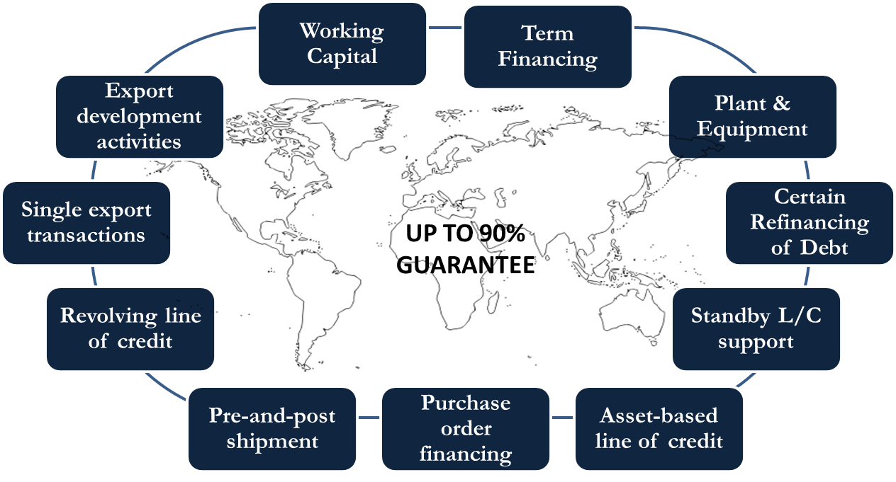
Capital (Export Finance)
SBA offers short- and long-term guaranteed export financing to help increase small business’s ability to compete in international markets.

Slide 8
SBA Loans for Exporters
SBA Export Financing Solutions
Working capital or fixed-asset financing
Financing to support export development activities
Short-term financing to support export orders
Long-term financing for support export expansion
SBA Export Finance Products
Export Express
Export Working Capital Program
International Trade Loan

Slide 9
SBA Export Financing Programs
Export Express
90% guarantee for amounts up to $350,000 (for up to 7 years)
75% guarantee for amounts between $350,000 and $500,000 (for up to 7 years)
Lender uses its own loan approval process and documents
For financing of inventory, accounts receivable and export development activities
Export Working Capital Program
90% guarantee for amounts up to $5,000,000
Use of funds for purchase order financing, accounts receivable and inventory financing
International Trade Loan Program
90% guarantee for amounts up to $5,000,000
For working capital term loans for financing and refinancing of fixed assets
used for exporting (loan tenures up to 10 years for plant & equipment
and 25 years for real estate)
Developing an Export Business Plan
www.sba.gov/exportbusinessplanner

Slide 10
Export Express
Proceeds may be used for any “export development activity,” such as:
1) export development including participation in a foreign trade show or translation services;
2) Transaction financing to support export purchase orders and/or to carry foreign accounts receivables;
3) issuance of standby letters of credit that serve as performance or bid bonds or advance payment guarantees; and
4) Term loans to buy equipment or real estate for export purposes.

Slide 11
Export Working Capital Programs
Advance rates:
75% against inventory, WIP
up to 90% again insured A/R
SBA: 90% guaranty to lender; $5 million maximum amount
no US content requirement; no prohibition on military sales
only Small Business applicants
Guaranty fee: ¼ of 1% on guaranteed amount, 12 months
Asset-based or transactional line of credit
Exim Bank: 90% guaranty to lender; no maximum amount
51% US content, no military sales, any size applicant
Guaranty fee: 1.75% on loan amount, 12 months
Typically asset-based loans

Slide 12
Bid & Performance Bonds and Advance Payment Guarantees
Standby letters of credit issued by a commercial bank can serve as a performance or bid bond or as an advance payment guaranty.
Funding support for Standby Letters of Credit can be provided by the following guaranty loan programs:
Export Express
Export Working Capital Programs—SBA or Exim Bank
The guarantee serves as an incentive to the bank to issue the standby letter of credit with less than full, 100% cash collateral (typically requires 25% cash collateral).

Slide 13
International Trade Loan
Maximum loan amount - $5 million
Maximum SBA guarantee portion of $4.5 million - 90%
Maximum SBA guarantee for working capital: $4 million
Maximum maturity: 10 years--working capital; equipment--10 years or useful life; 25 years--real estate
Eligibility requirements: The applicant
Will expand an existing export market or develop new export markets as a result of financing, or
Can demonstrate it has been adversely impacted by imports and needs to modernize or retool operations; and
The loan will improve the applicant’s competitive position.

Slide 14
Indirect Exports
Applicants who produce products or services that enter into the export channel, but do not directly export their products:
Manufacturers using an Export Trading Company
Suppliers to other domestic manufacturers that export directly: supply chain financing solution
Requires certification from domestic customer that goods are, in fact, being exported.
Can now be supported by all three of SBA’s core export loan programs: EWCP, Export Express, International Trade Loan

Slide 15
Small Business Definition
Manufacturers: <500 employees generally; can go as high as 1,500
Or, applicant can use the Alternative Size Standard:
companies with less than an average of $5 million in net income for the past two fiscal years and a net worth less than $15 million.

Slide 16
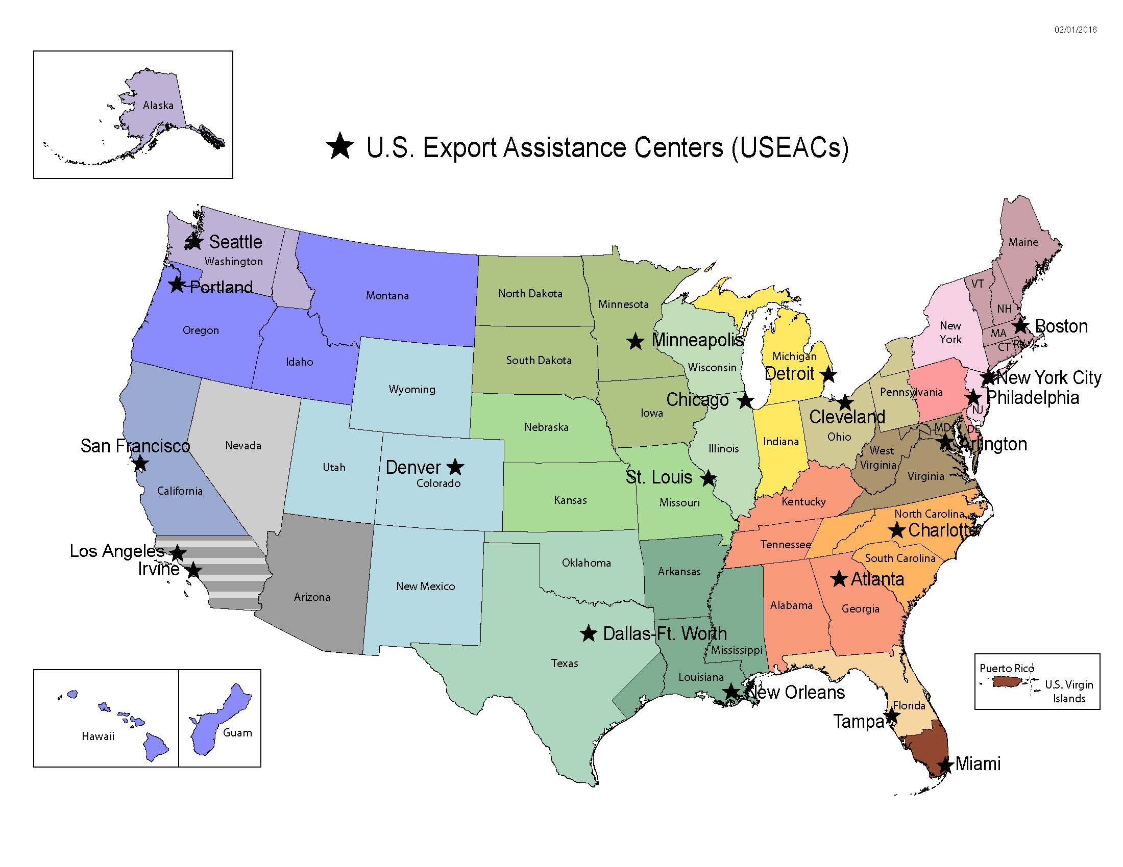
Directory of SBA Export Finance Managers: https://www.sba.gov/international

Slide 17
SBA’s Network of Export Finance Managers at U.S. Export Assistance Centers
ATLANTA
Territory: Georgia, Alabama, Kentucky, West/Central Tennessee
David.Leonard@sba.gov -- 404-815-1496
ARLINGTON, VA
Territory: Virginia, Maryland, District of Columbia, West Virginia
William.Houck@sba.gov 202-557.4063
BOSTON
Territory: Maine, Vermont, New Hampshire, Massachusetts, Connecticut, Rhode Island
John.Joyce@sba.gov 617-565-4305
CALIFORNIA
IRVINE
Territory: Southern California, Nevada
Martin.Selander@sba.gov 949.660-8935
LOS ANGELES Territory: Southern California, Arizona Pellson.Lau@sba.gov 213-894-8267
SAN FRANCISCO
Territory: Northern California – Bakersfield
to the Oregon border
Jeff.Deiss@sba.gov --415-744-7730
CHARLOTTE
Territory: North Carolina, South Carolina, Eastern Tennessee
Dan.Holt@sba.gov 704-333-4886 x226
CHICAGO
Territory: Wisconsin, Illinois
Dennis. Foldenhauer@sba.gov 312-353-8065
CLEVELAND
Territory: Ohio, Western New York, Western Pennsylvania,
Patrick.Hayes@sba.gov 216-522-4731
DALLAS/FORT WORTH
Territory: West/North/Central Texas, Oklahoma
Alale.Allal@sba.gov 817.684.5506
DENVER
Territory: Colorado, New Mexico, Utah, Wyoming
Bryson.Patterson@sba.gov 303-844-6622
DETROIT
Territory: Michigan, Indiana
John.Ogara@sba.gov 313-226-3038
FLORIDA
MIAMI
Territory: S. Florida , Puerto Rico, Virgin Islands
Mary.Hernandez@sba.gov 305-526-7425 ext. 21
TAMPA
Territory: Central & North Florida
Sandro.Murtas@sba.gov 727-464-7177
MINNEAPOLIS
Territory: Minnesota, North Dakota, South Dakota
Carlos.Sosa@sba.gov 612-348-1642
NEW ORLEANS- Louisiana, Arkansas, Mississippi, Gulf Coast of Texas—Houston
Reginald.Harley@sba.gov 504-589-6730
NEW YORK CITY
Territory: New York City & 5 Boroughs, Eastern Upstate New York, New Jersey
Vacant 212-809-2645
PHILADELPHIA
Territory: Eastern Pennsylvania, Delaware
Robert.Elsas@sba.gov 610-382-3069
PORTLAND
Territory: Oregon, S. Idaho, Montana; Hawaii & Guam
James.Newton@sba.gov; 503.326.5498
SEATTLE
Territory: Washington, Alaska, N. Idaho, Leland.Gibbs@sba.gov; 206-553-0051 ex.228
ST. LOUIS
Territory: Kansas, Missouri, Nebraska, Iowa
Larry.Cresswell@sba.gov; 314.260.3788

Slide 18
Questions?
Bill Houck
Regional Export Finance Manager
Office of International Trade/SBA
Arlington, VA USEAC
william.houck@sba.gov
202.557.4063

